Slide 1
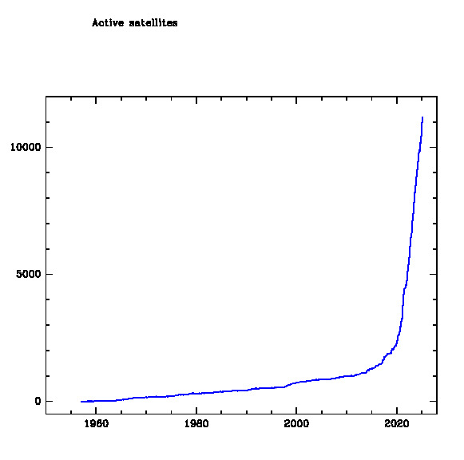
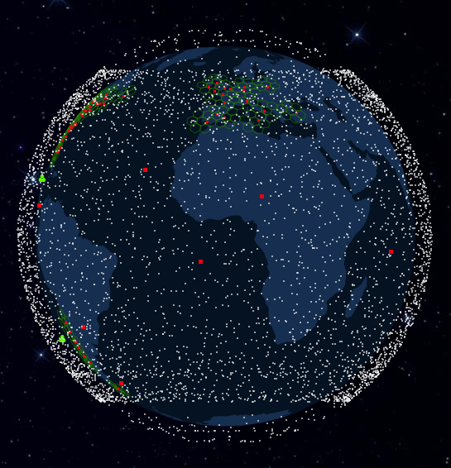
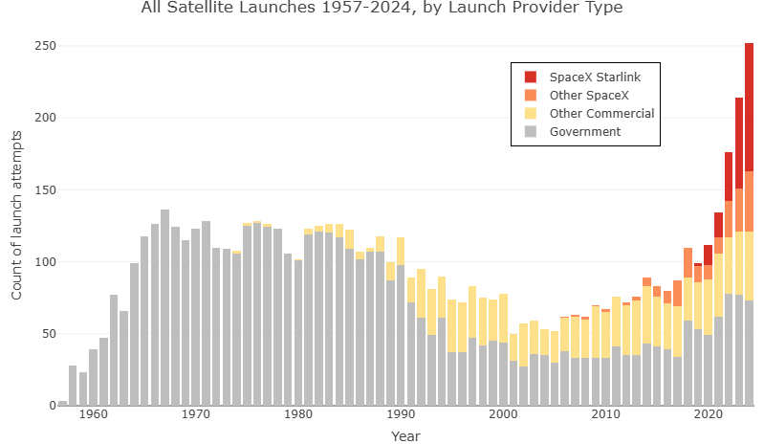
https://satellitemap.space/
Notes:
7000 satellites, all put up within the last five years. 20-60 satellites per launch.
12,000 active satellites. 60% of them are Starlink. Another x went up on Sunday, and another x planned for this week.

Slide 2
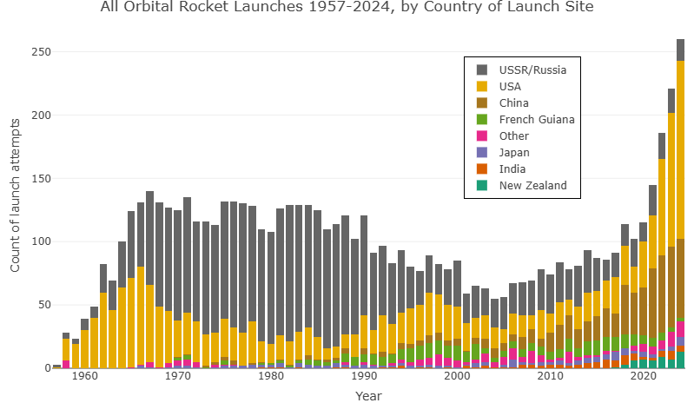
D

Slide 3
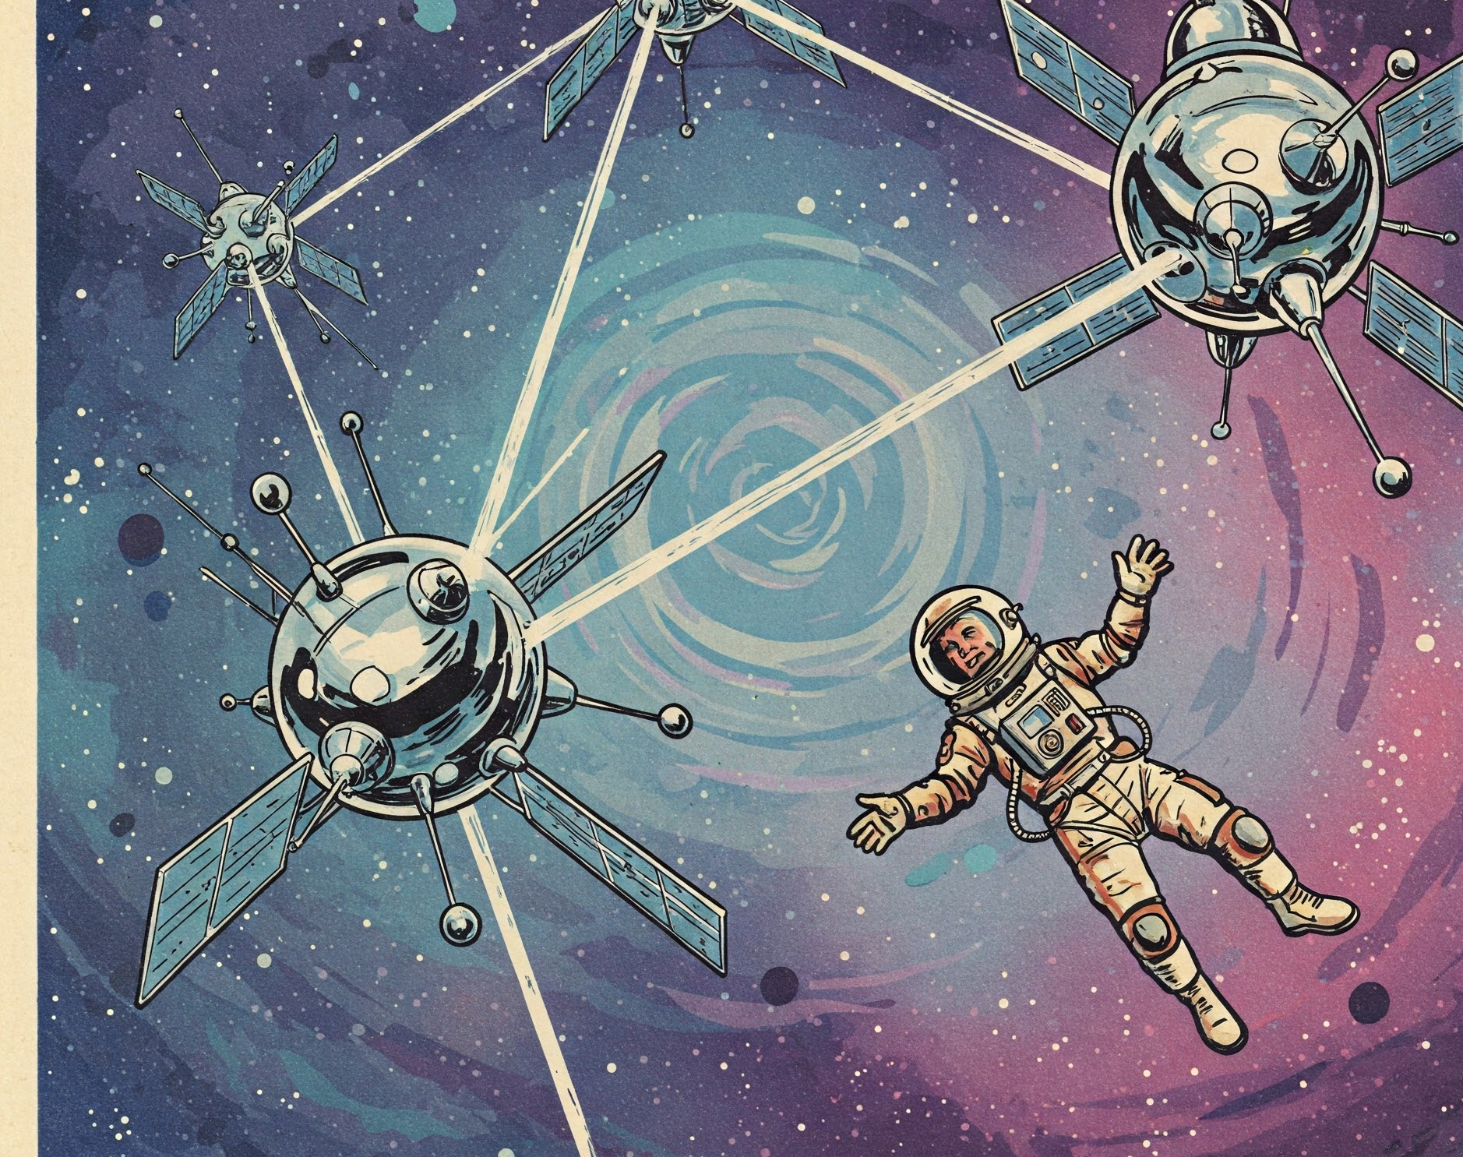
From Sputnik to Starlink A Brief History of Putting Stuff in Space
Daniel Wrench
SPCE101
March 2025
AI-generated artwork from Gemini
Notes:
How did we get here? What has made SpaceX so dominant, so quickly? How has the rise of China affected US space policy? Are we all moving to Mars to work on Elon Musk’s colony, or do we need to wait before strapping into the rocket and think about whether we’re doing all this responsibly? Spoiler – it’s the latter.

Slide 4
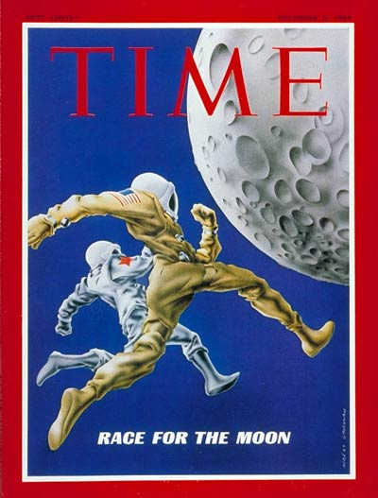
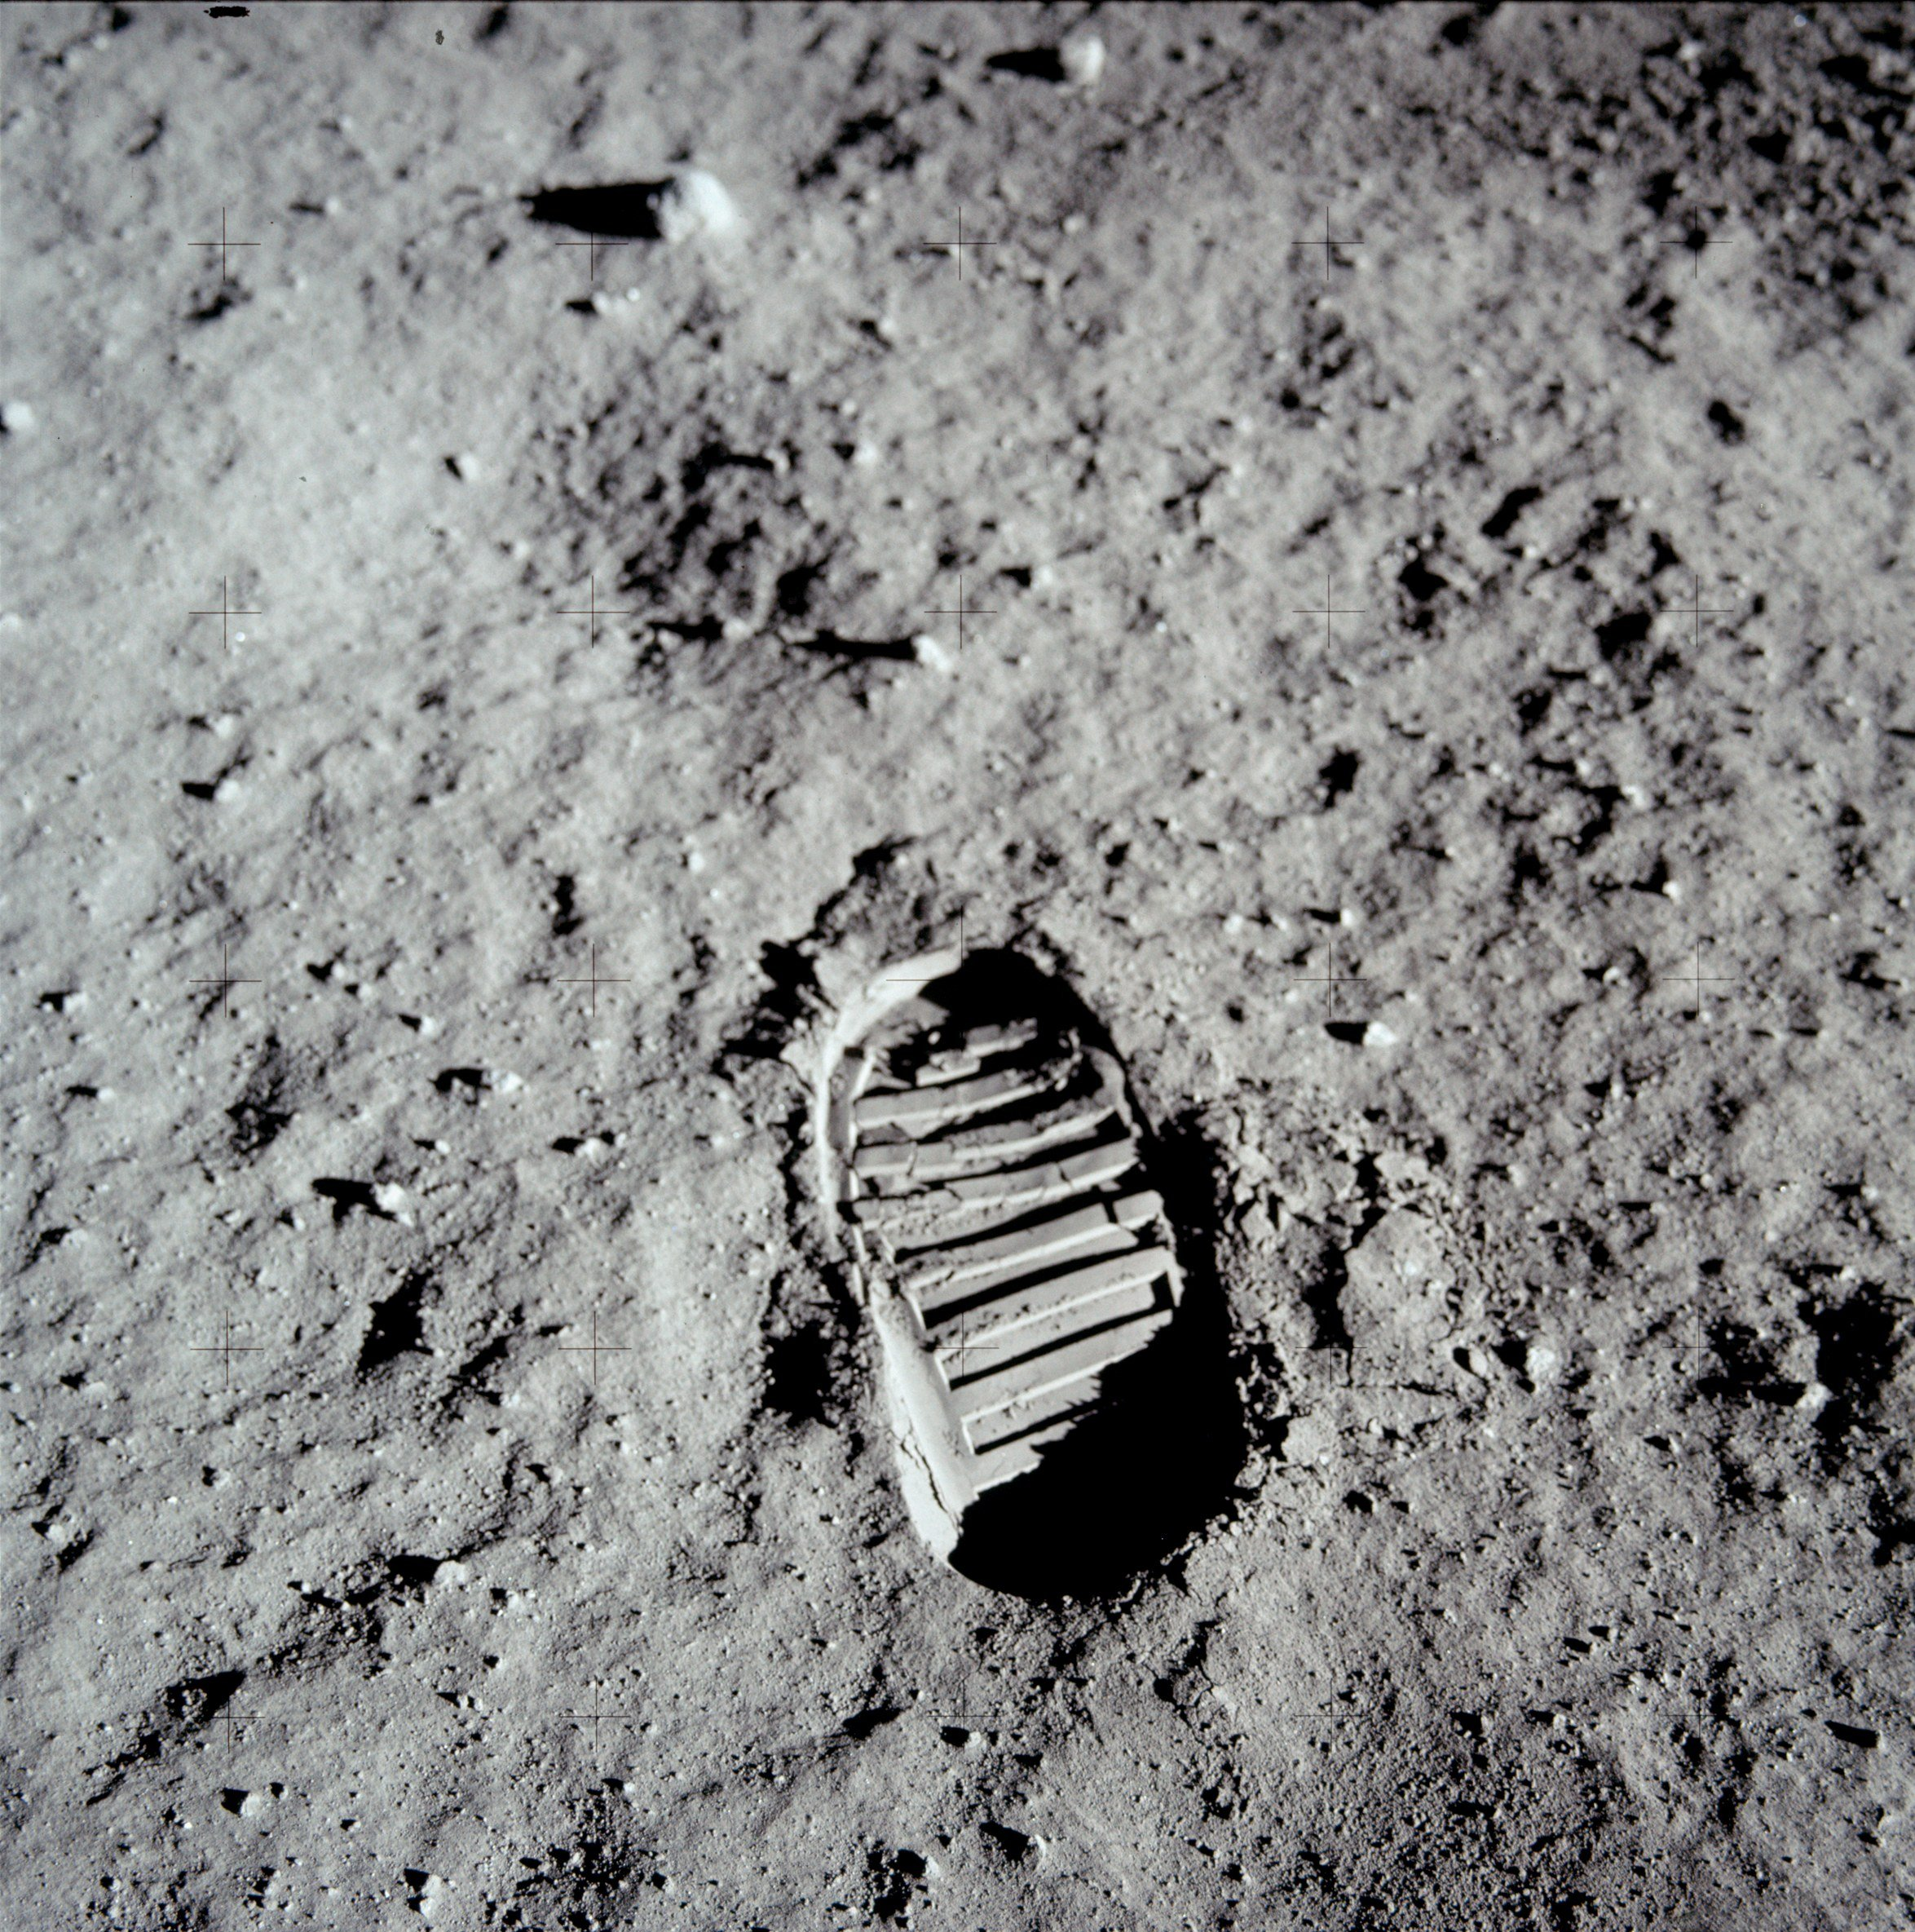
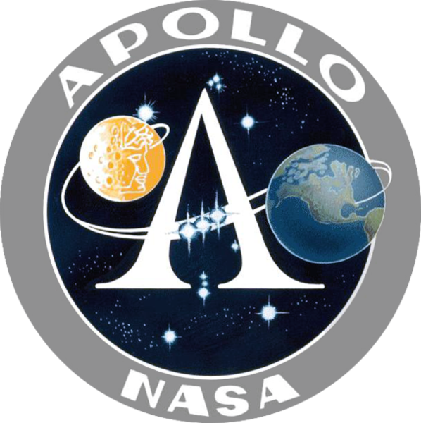
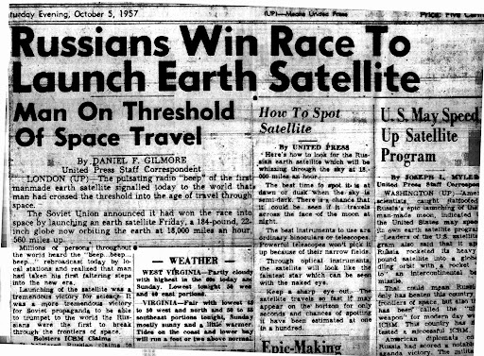
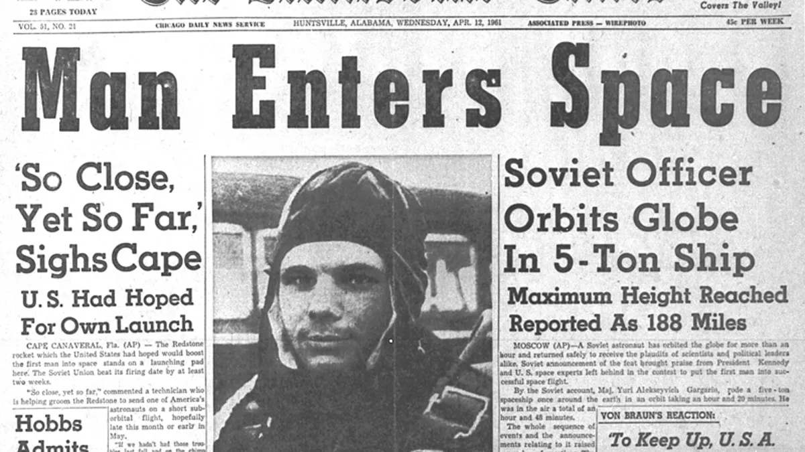
2 questions for sending humans into deep space
Why?
Nationalism
Scientific discovery
Economic benefit
Long-term survival
How?
Rocket
Capsule
Lander
1961-1972
1961
1957
Notes:
Cold War stand-off: US/USSR, capitalism/communism.
Sputnik, anyone know? Gagarin: bay of pigs fiasco few days later. Sense of foreboding amongst the American public towards the Soviets. They felt a need to prove America’s technological superiority not only to themselves, but also to all the newly independent countries that decolonised after WWII and were looking for which superpower to align with

Slide 5
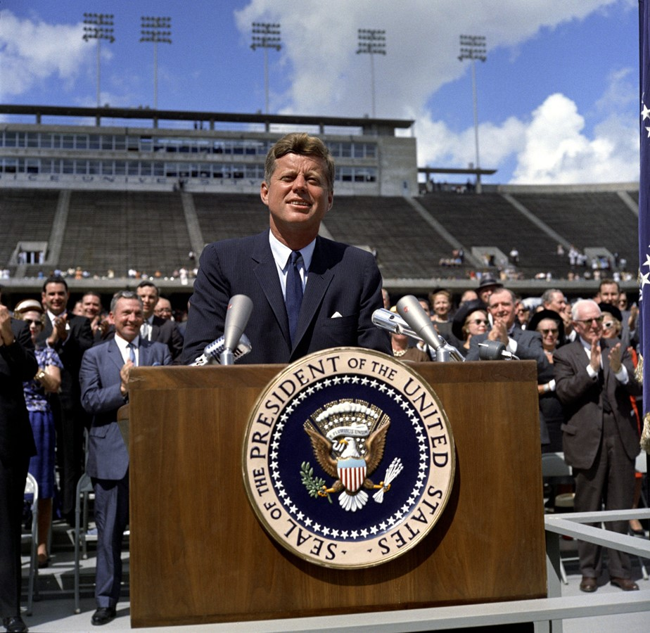

Let’s go to the Moon for knowledge and peace!
Please, let’s beat the Soviets at something
And do it before the decade is out!
1962
Notes:
So in response to this, JFK came along and moved the goalposts of the space race 400,000km away. He challenged his nation to go to the Moon – not because it was easy, and not because it was man’s destiny or scientifically valuable – but because it was hard. Specifically, hard enough that it might give them time to overtake the Soviets. Because underneath his soaring oratory about the greatest adventure on which man had ever embarked: this was really cold hard political pragmatism. And he really was pragmatic about it. Kennedy set an ambitious but realistic deadline, and when he took it to Congress, he was upfront that this would cost a lot of money. He very prudently made clear, the nation must decide wholeheartedly whether or not this should be a priority.
Congress said yes, and the purse strings opened.
Source: https://www.jfklibrary.org/asset-viewer/archives/jfkwhp-1962-09-12-a#?image_identifier=JFKWHP-KN-C23643

Slide 6
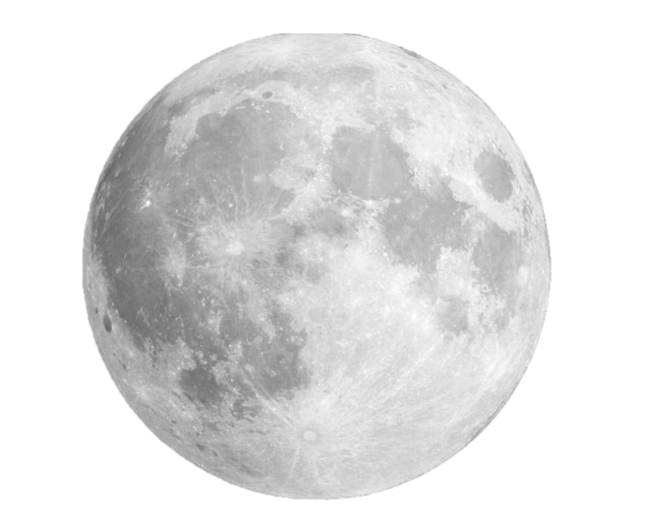
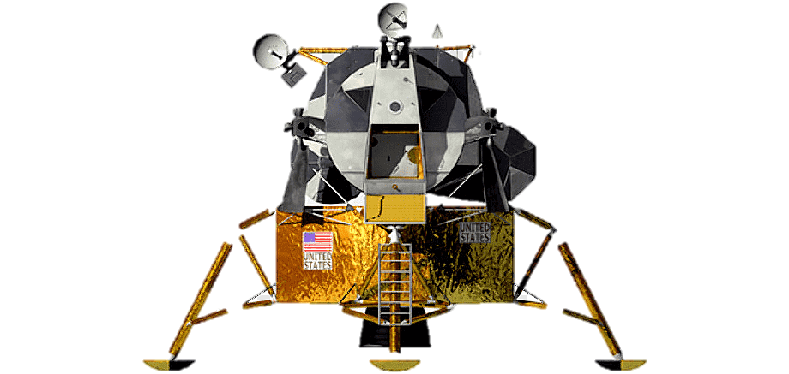
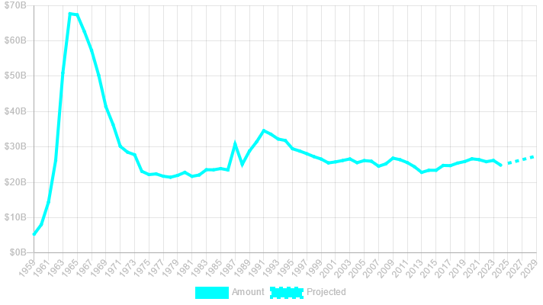
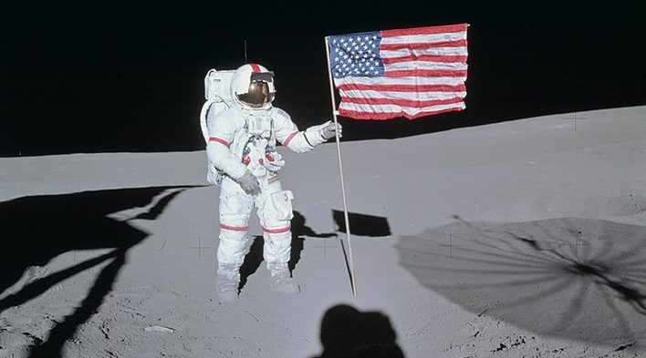

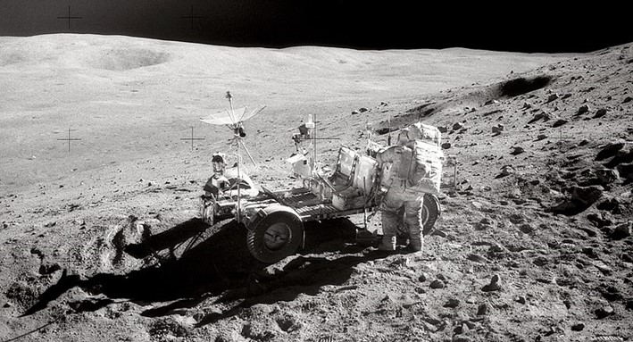
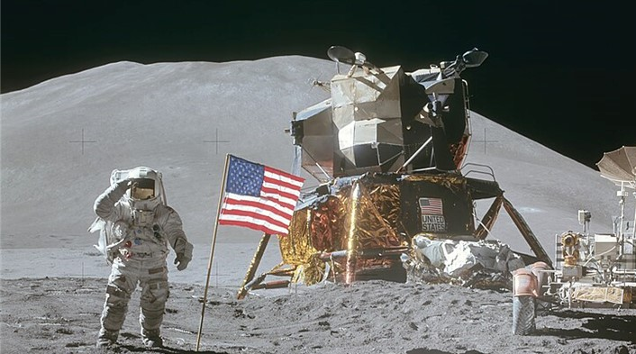
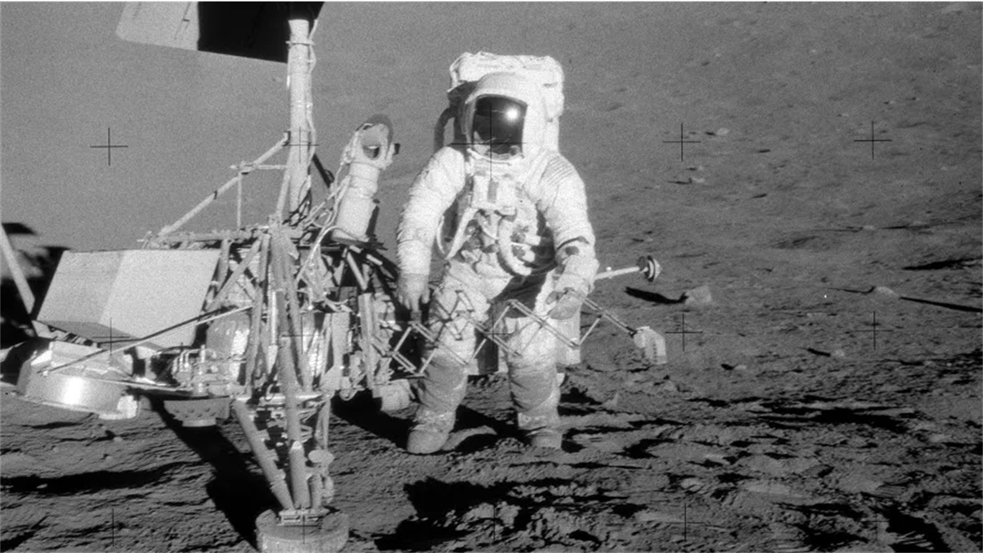
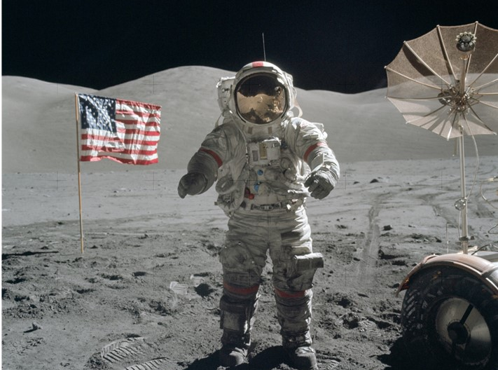
History of humans in space
November 1969
February 1971
April 1972
July 1971
December 1972
July 1969
NASA budget (USD)
Notes:
Source: https://www.planetary.org/space-policy/nasa-budget
Project Apollo was funded to the tune of $300 billion USD in today’s money. In an incredible feat of management, let alone engineering, NASA’s workforce of 300,000 met the now-dead Kennedy’s deadline with 6 months to spare. July 1969, the Eagle landed, Neil made his one small step, and the world stood still, crowded around radios and TV sets to witness this triumph of not just the US but of humanity. HOLD UP NEWSPAPER, quote headline. If we have time at the end, I’d love to hear any memories you have of this time.
American taxpayer got not just one landing, but 6, out of 7 attempts. But as soon as Apollo 12, people started tuning out. The public sentiment was, we’ve beaten the Russians – wasn’t even much of a competition in the end - and there was only so excited people could get about grey rocks, even ones from space.
Combine that with the Vietnam War and civil unrest, US had no appetite to continue such a costly program, and funding plummeted.

Slide 7
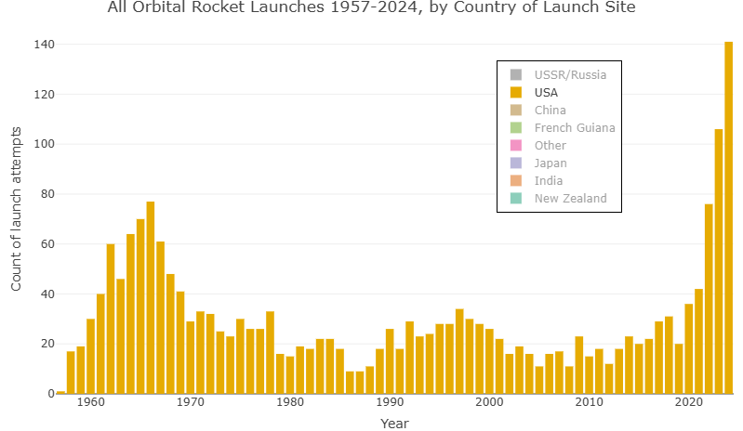
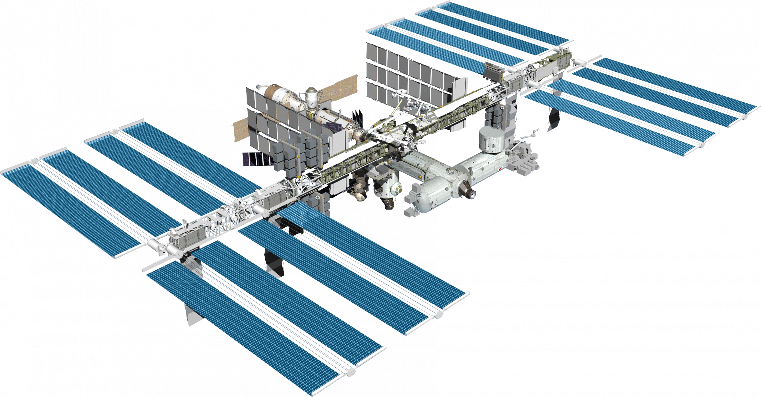
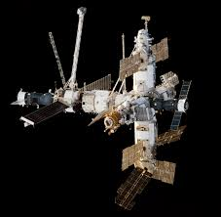

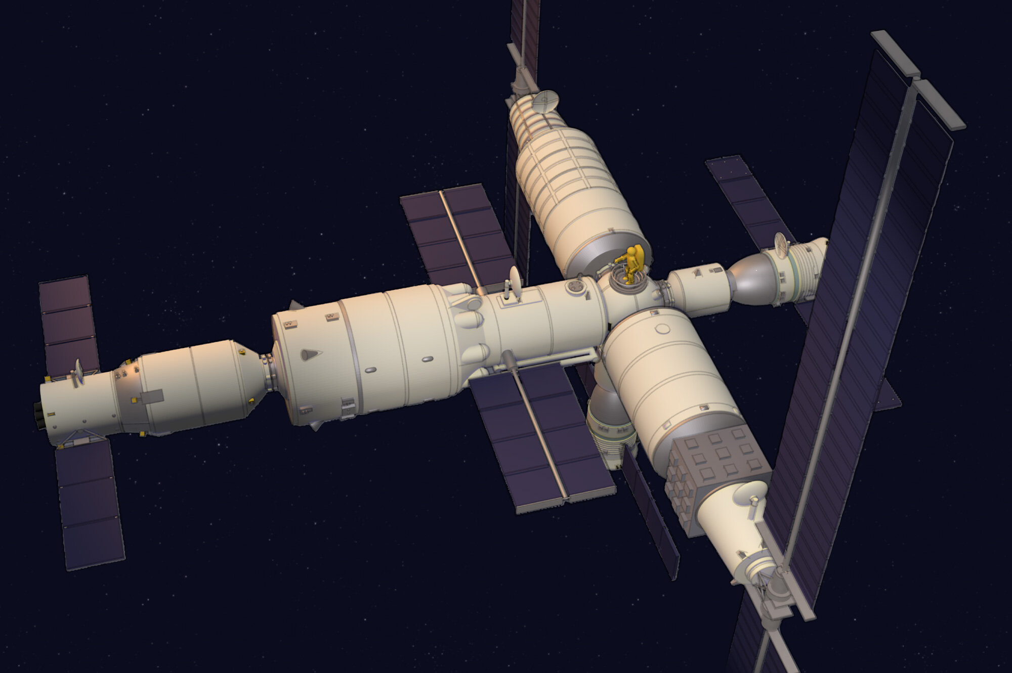
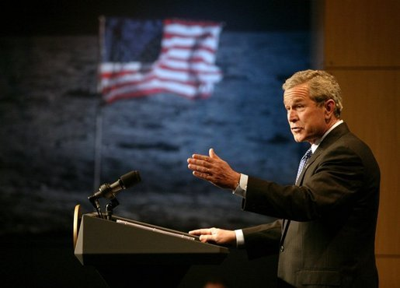

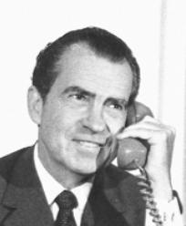
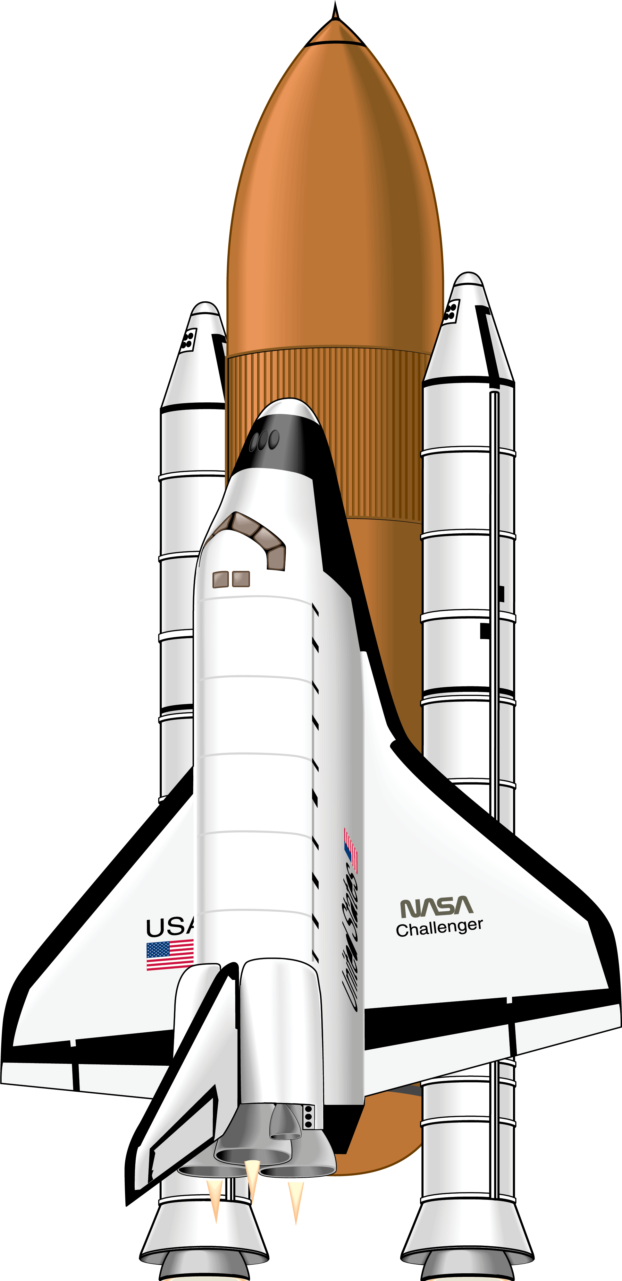
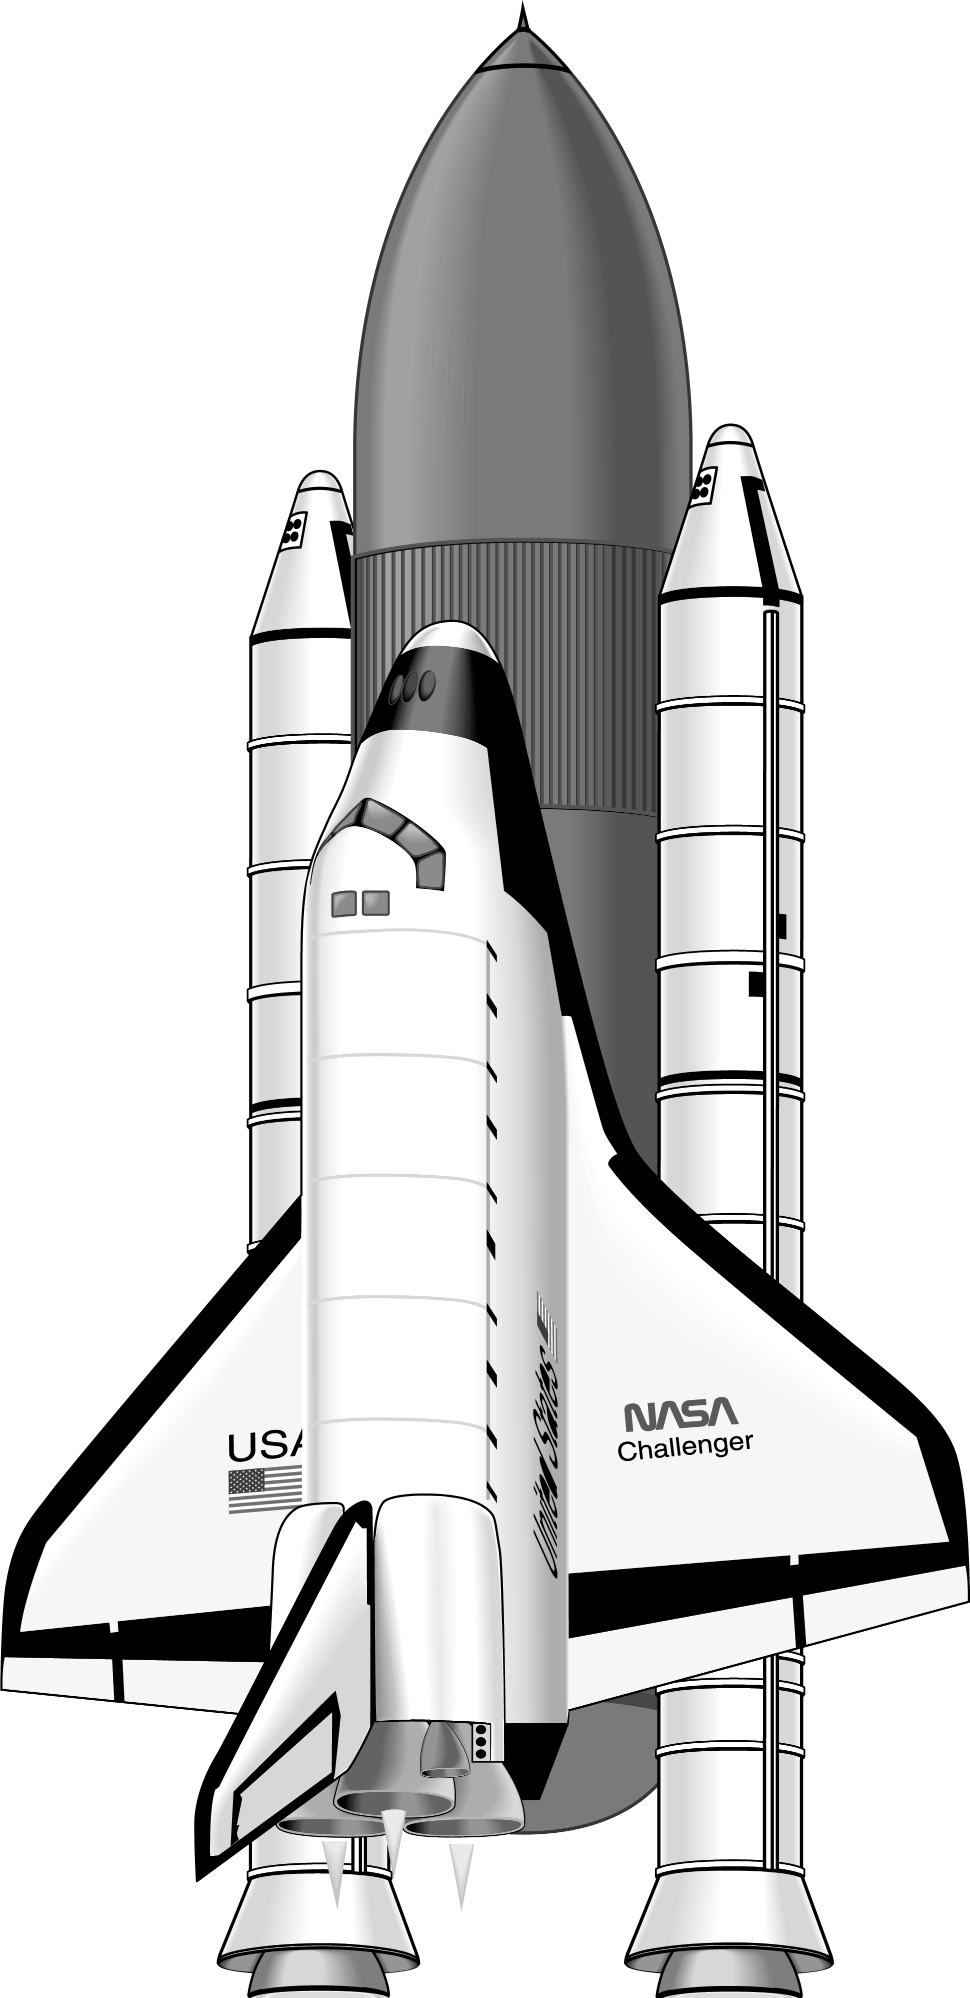
History of humans in space
Apollo 1969-72
International Space Station 1998-2030?
Mir 1986-2001
NASA budget (USD)
Tiangong 2021-
Challenger 1986
Columbia 2003
Space Shuttle 1981-2011
Notes:
Source: https://www.planetary.org/space-policy/nasa-budget
After peaking at 4% of federal budget in 1965, NASA’s allocation has since hovered between 1 and ½% of all US government spending, and humans have never reached those heights since.
What exactly has happened since? Well in robotic exploration, NASA has had huge accomplishments: the Voyager probes launched in the 70s took the first photos of the gas giants and are still transmitting data, now having left the solar system. Nixon was the president who got to call up Neil and Buzz on the Moon, major influence on spaceflight policy for rest of century. After denying another big expensive program signed into law the space shuttle, which was supposed to be a much more economical way of accessing space. Shuttle went on to have 30-year program, crowning achievement building the ISS, now continuously occupied for more than 20 years by people from 15 countries. Including Russia and the US working together, even to this day. Russia and China have also had their own space stations over the years.
Despite this amazing contribution of building the ISS, the shuttle was by all accounts a policy failure. Supposed to provide affordable, regular and reliable access to space. Failed on all 3 counts. Two shuttles were lost. After Columbia, George W Bush came along, aiming to set a new, post-shuttle direction for NASA.
Since Apollo, human spaceflight = “science experiments and somersaults”
Reagan approved station, Clinton brought in Russia

Slide 8
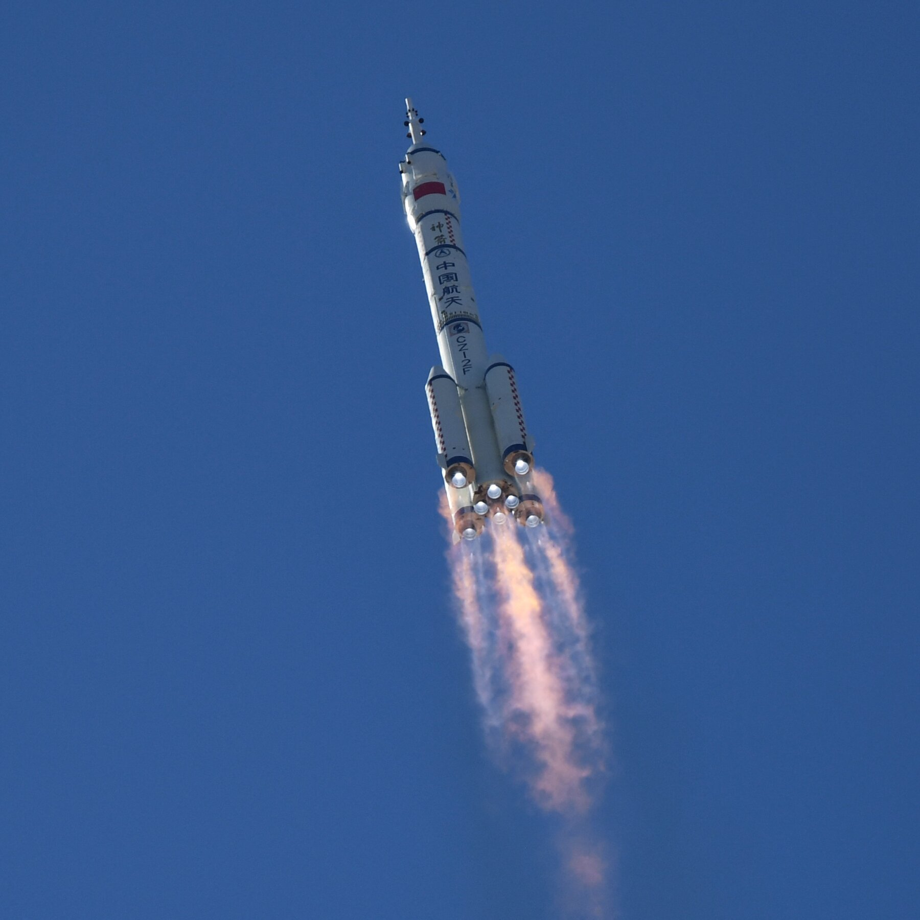
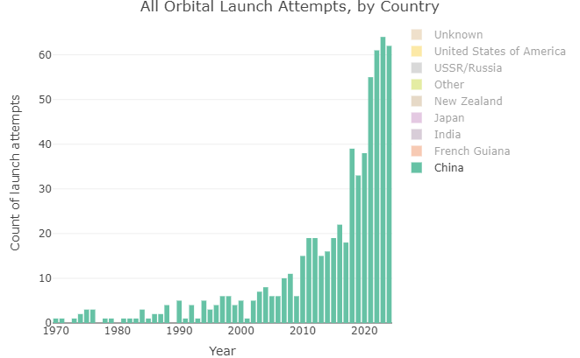
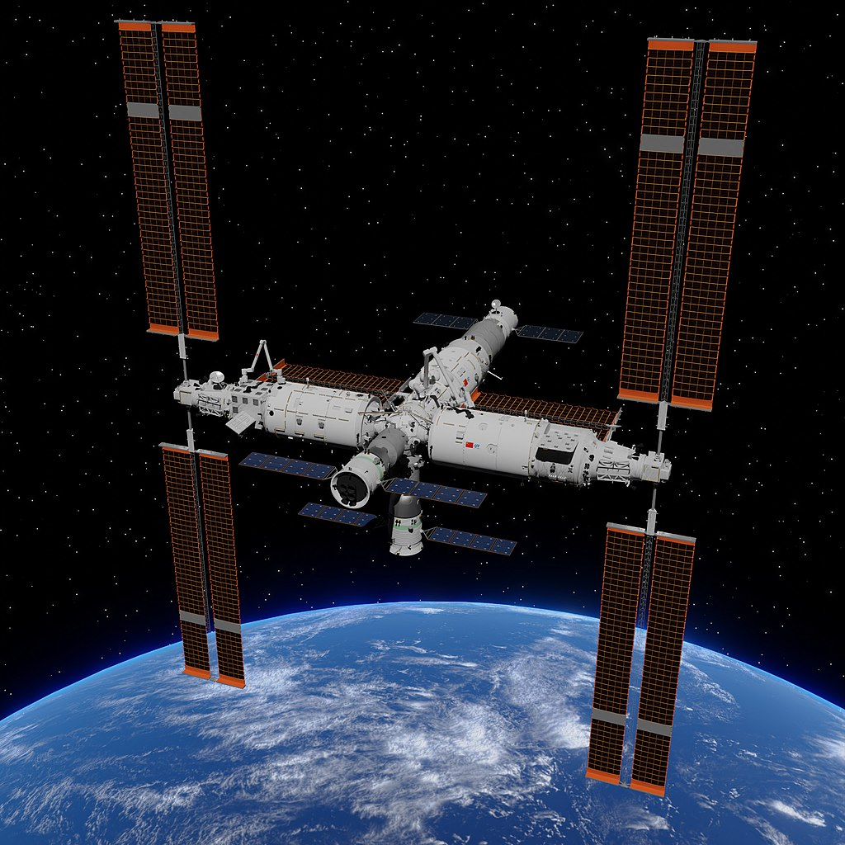

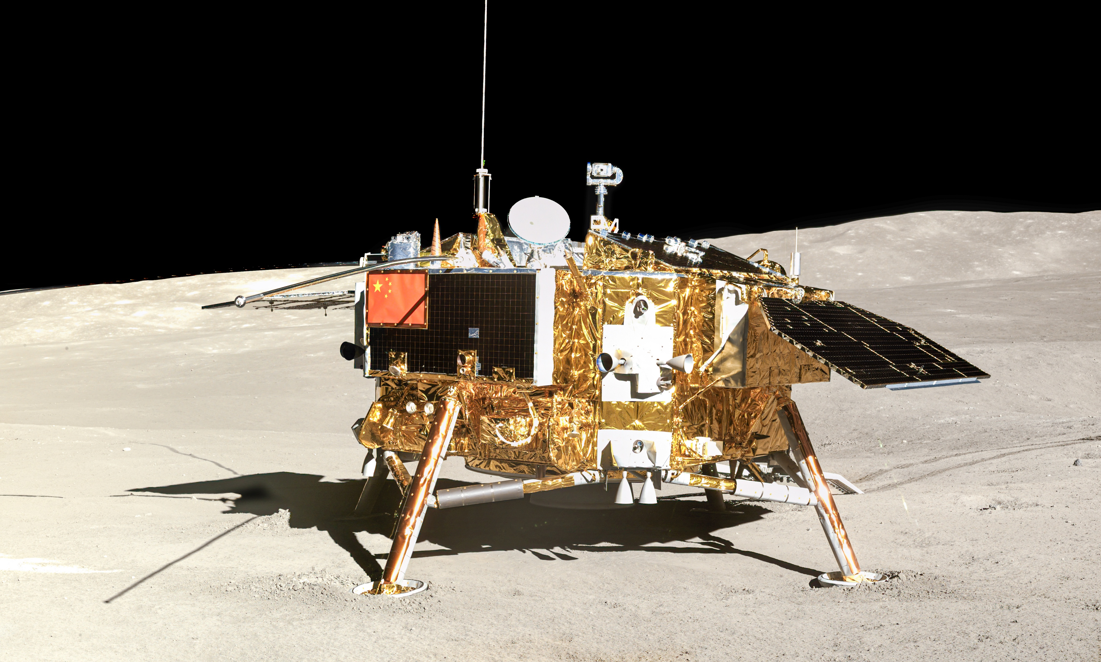
The Rise of China
Tiangong space station
Chang’e 4 lunar lander
Notes:
Operating one of 2 space stations, 1/3 size of ISS

Slide 9
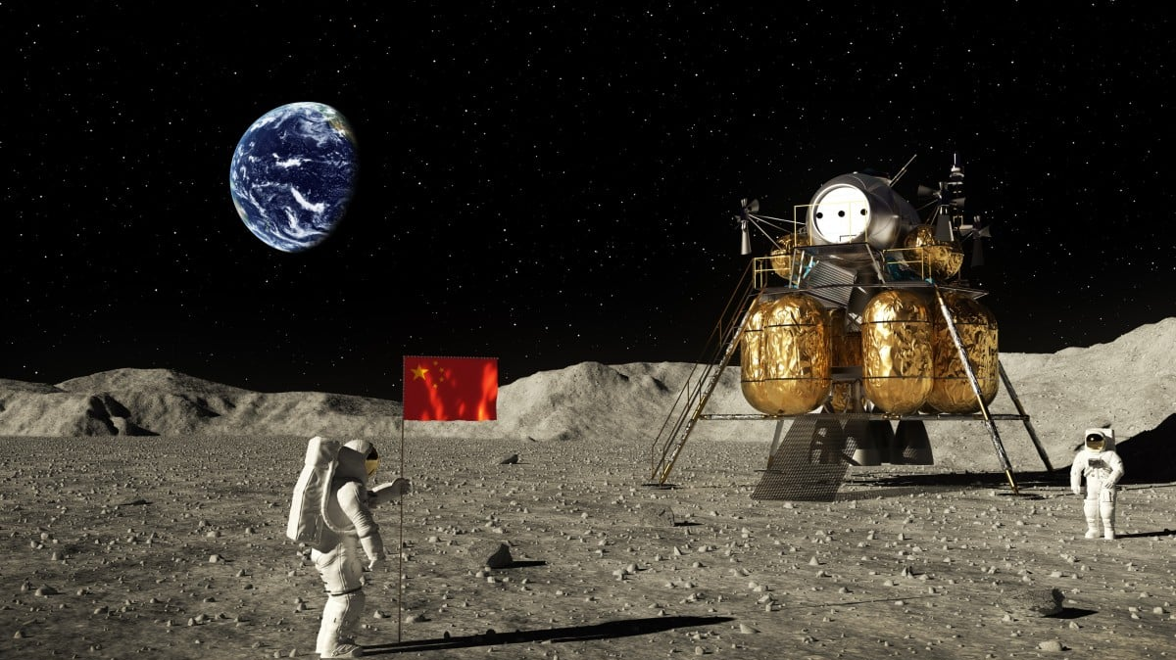

NEW YORK TIMES, 29th MAY 2023
Notes:
Part of the reason China and many other countries are interested in going to the Moon, is that water ice was discovered there. Could make the Moon a pit stop of sorts on the way to the rest of the solar system.

Slide 10

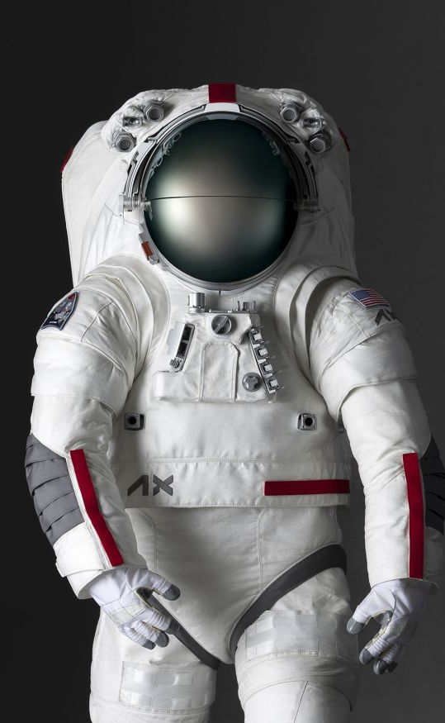
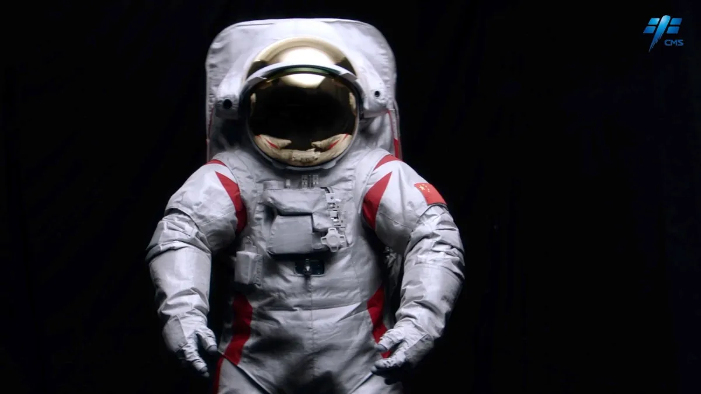
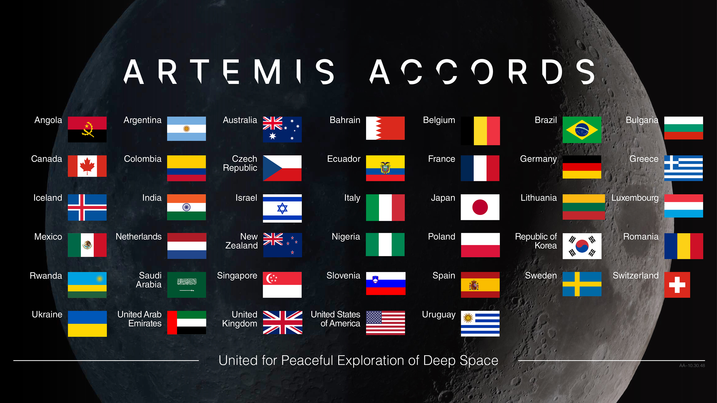
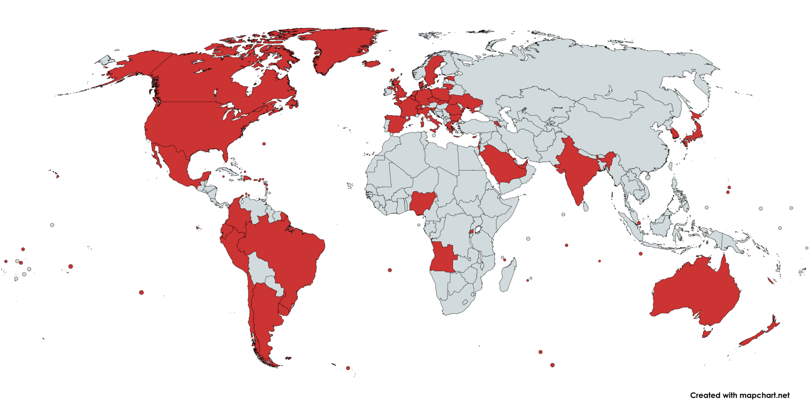
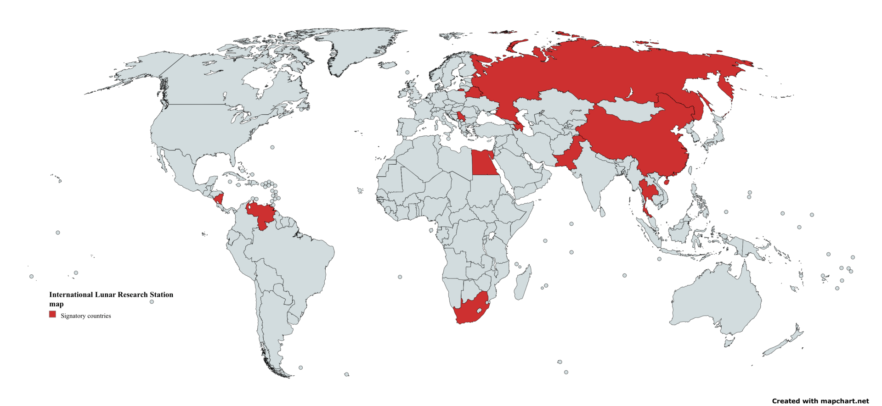
21st century space race? International cooperation and competition
International Lunar Research Station
Notes:
So, ostensibly, there is another space race of sorts. But it’s not like it was in the 60s, partly because today, space is as much about cooperation as it is competition.
The Trump Admin’s SPD-1 explicitly mandated going back with international partners. Been building coalition under the Artemis Accords, set of ground rules for operating on and around the Moon and Mars: 48 nations signed so far, including NZ
Meanwhile, China and Russia are gathering partners around their planned lunar base.
Interesting to note there’s a very low barrier to signing on to these agreements: more than half the signatories of the Artemis Accords have no formal space program. Clearly states take national pride in simply being associated with these endeavours, while also having the door open to actually contributing.
Excitingly, we’re seeing that getting things to the Moon is within the means of an increasing number of actors. Well, at least sending them there… landing is another thing.

Slide 11
Space! What is it good for?
For making your country look cool
For spying on your enemies
For studying the Earth, Solar System, Universe
For making money???
Notes:
That first one was a major priority during the Cold War, so the US Congress could turn a blind eye to the exorbitant cost. But now people have found ways to make money.

Slide 12






Notes:
Really been one company that has revolutionised the economics of spaceflight. Anyone know how they did that?

Slide 13
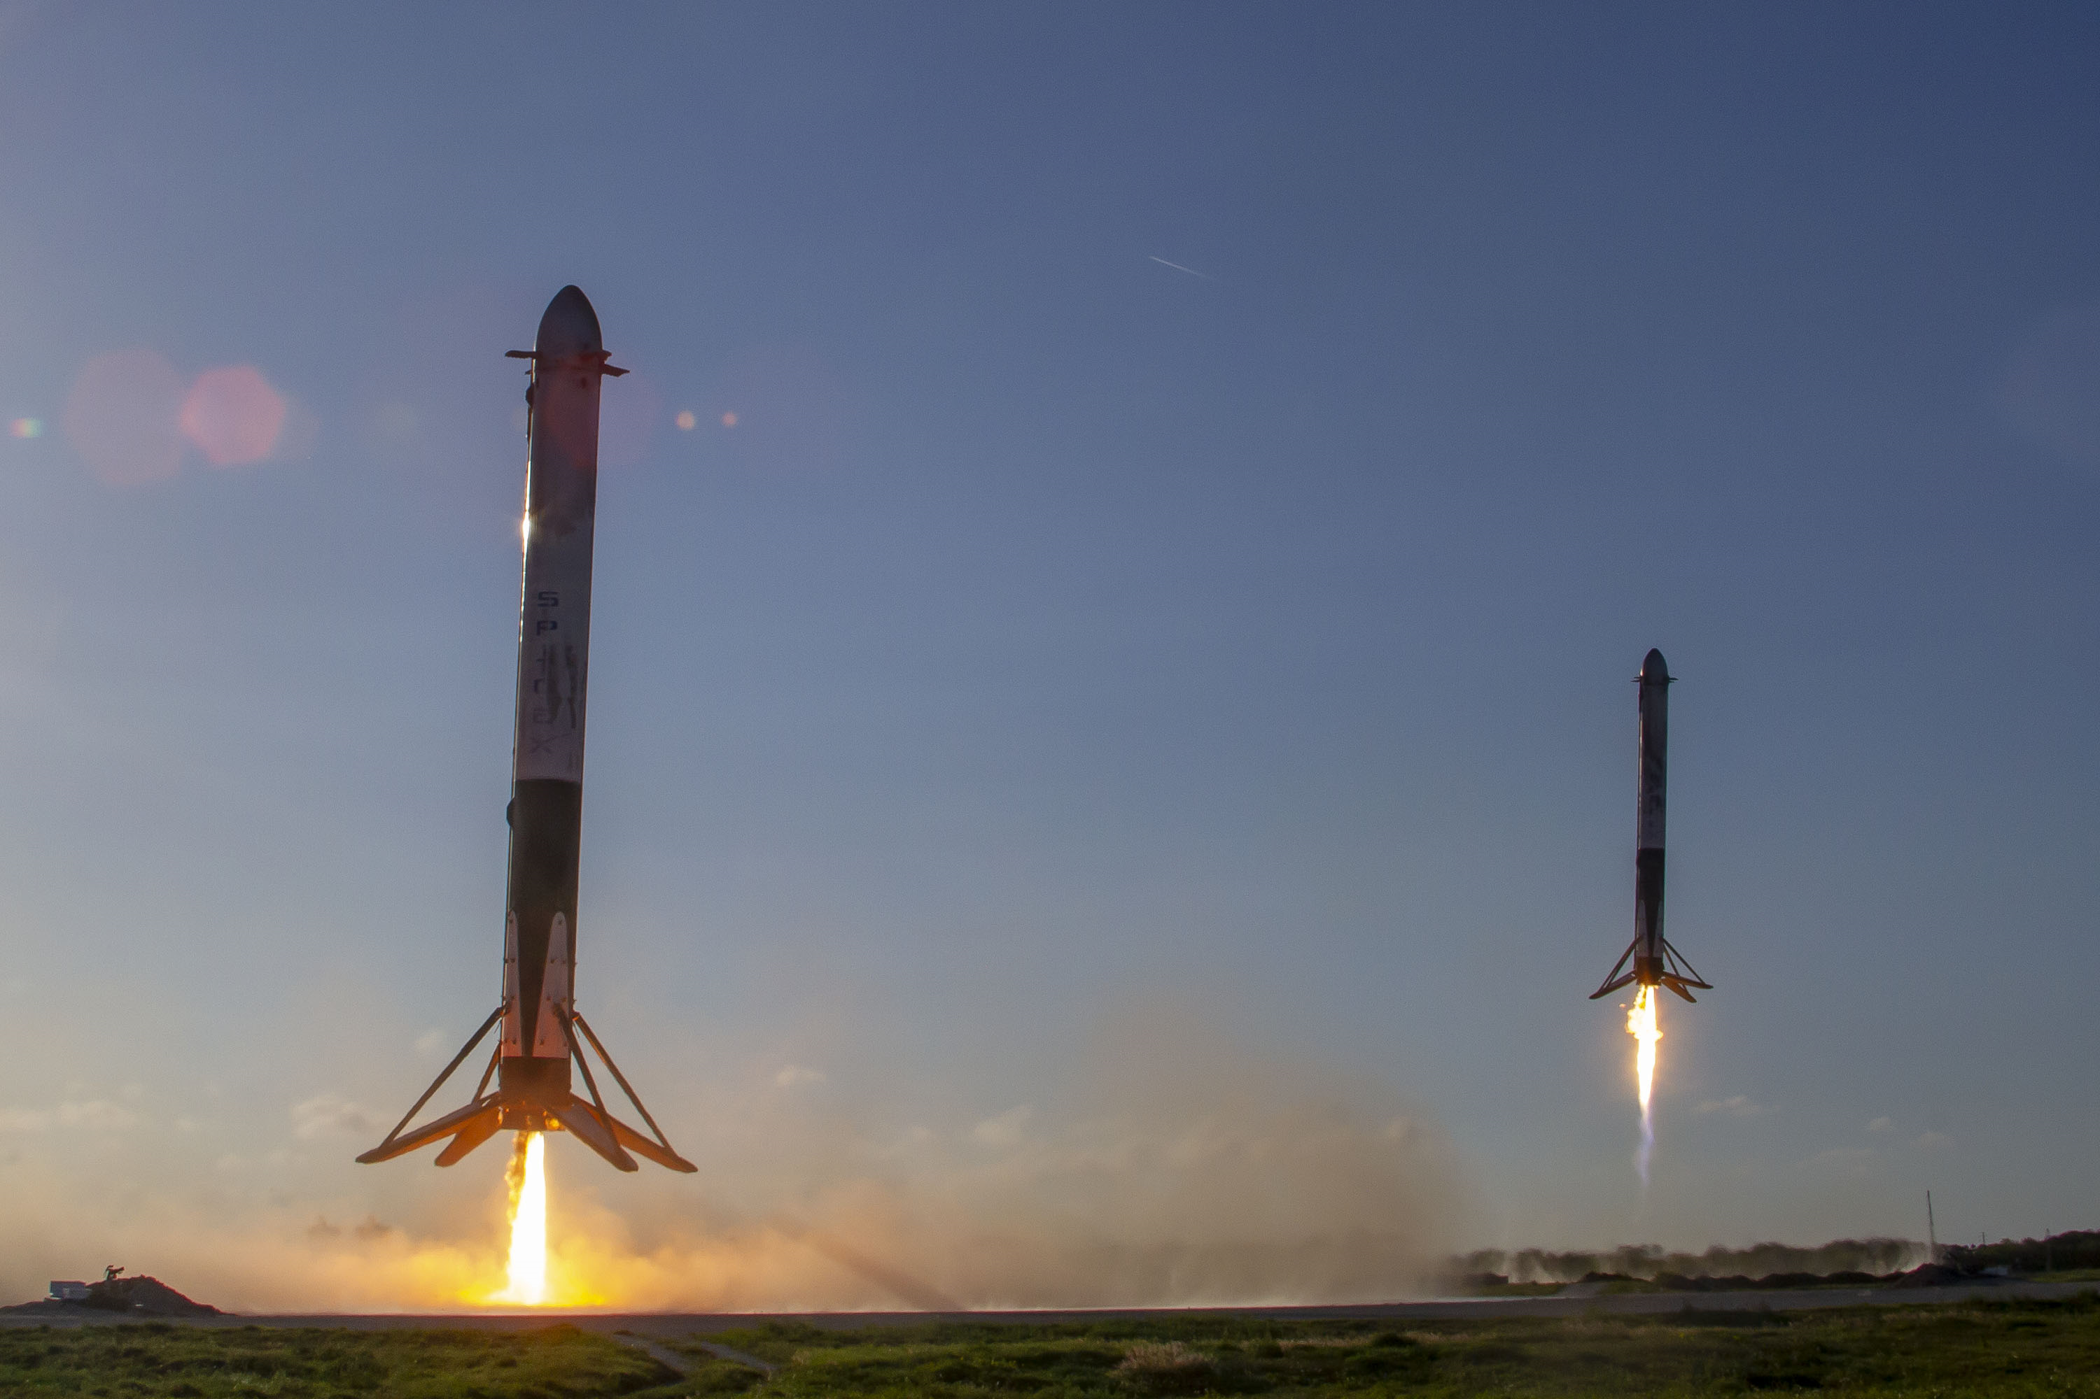
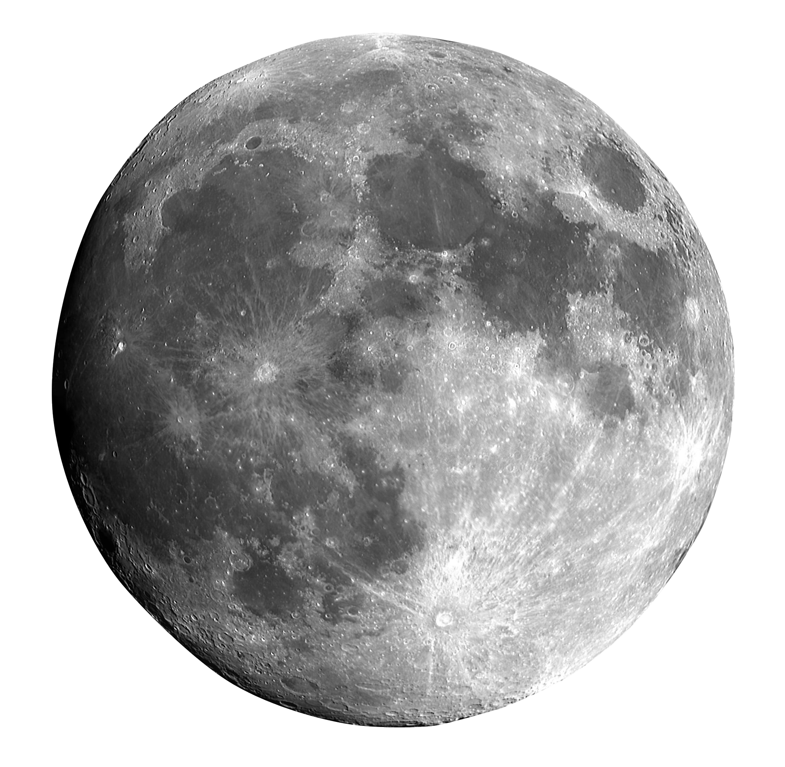

GAME CHANGER
#2
THE RISE OF
and controlled descent
^
Only rockets to re-use first stage, decreasing $/kg to orbit by 80%
4-year (and counting) monopoly on launching humans from US
Currently developing a fully and rapidly re-usable super-heavy lift vehicle…
… for transporting humans beyond low-Earth orbit
Notes:
Most technology has improved drastically since the 60s. But one area where it’s remained stubbornly retro, and therefore expensive, is rocketry. The price of sending stuff to orbit has been stuck at around $10,000kg. Until this company came along and pioneered reusability. Having landed boosters over 300 times, re-used them up to 22 times each. Resulted in massive cost reduction.
In 2020, under NASA’s commercial crew program, SpaceX ended the USA’s reliance on paying the Russians to take their astronauts to the ISS. Since then, they’ve had a monopoly. Just when it looked like that was finally broken by Boeing, as you’ll have heard in the news recently, their capsule is still playing up after years of delays.
As we’ll see later on regarding this last bullet point, NASA is relying once again on SpaceX for Artemis

Slide 14
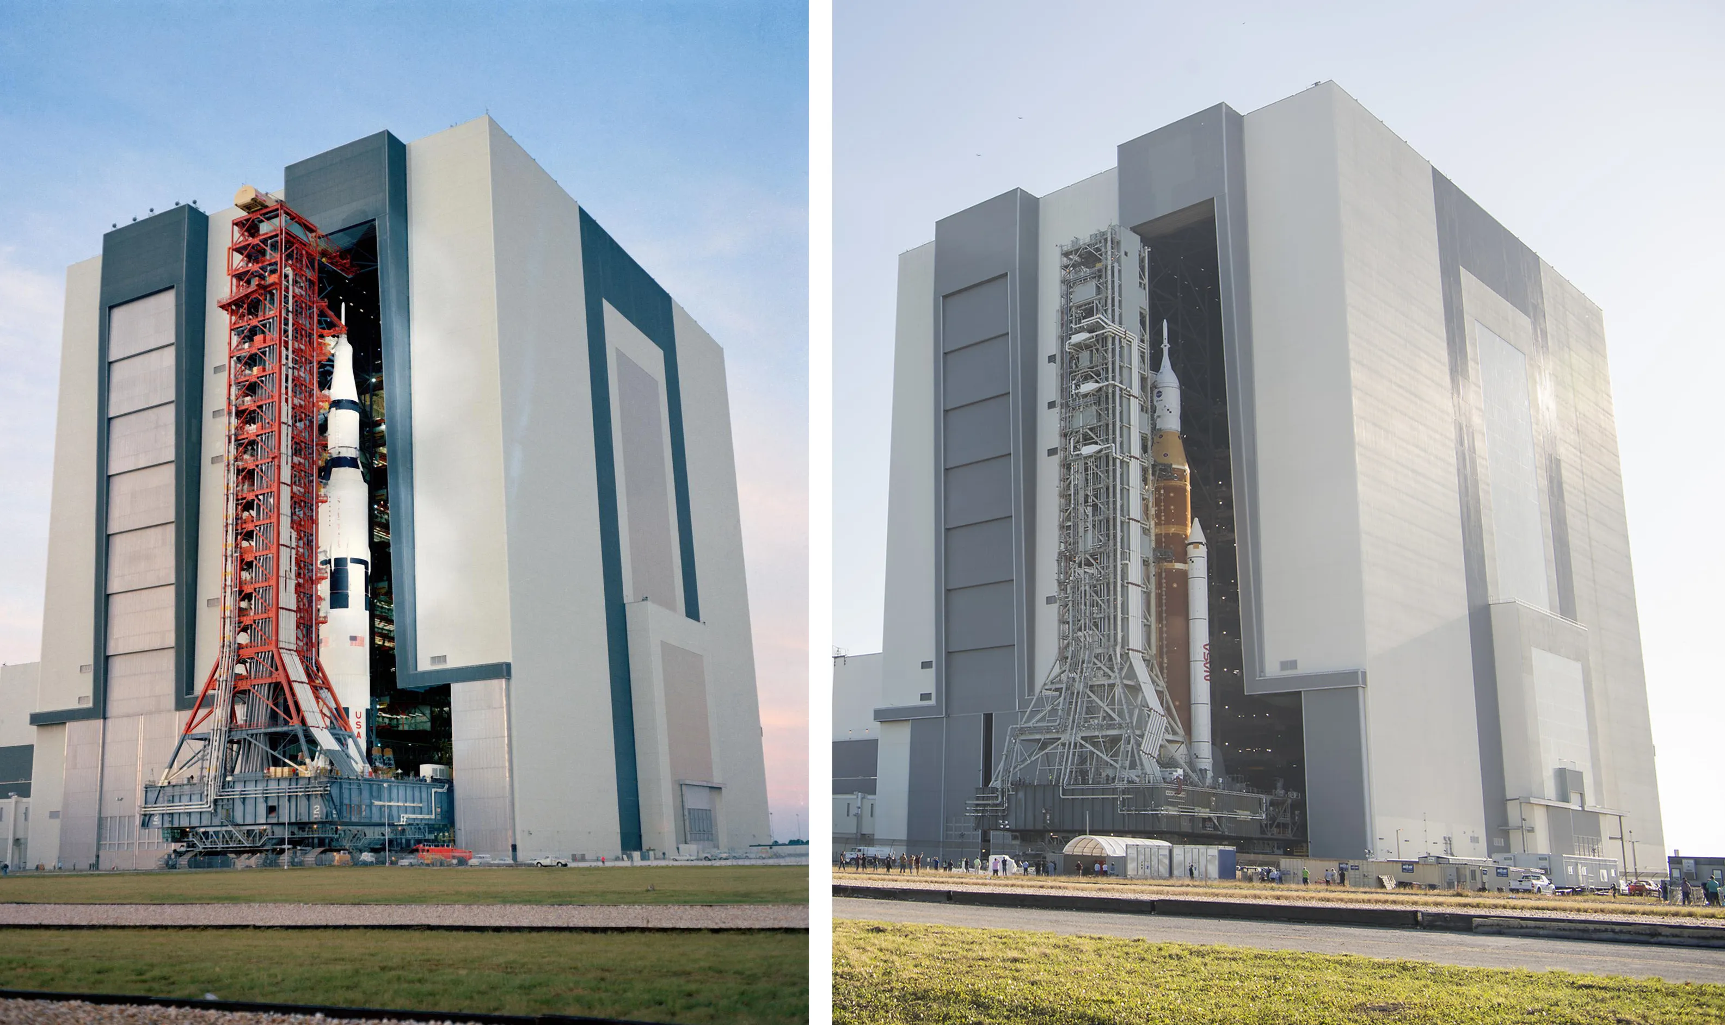
1971
2022
Notes:
After years of delays and cost overruns by Boeing and the other contractors, they eventually got the rocket on the pad in 2022, slowly rolling out of the same giant hangar that the Saturn V did all those years ago. Even then, just to keep everyone on their toes, the launch was delayed for weeks by hydrogen leaks and a hurricane at the pad. Finally, it took the skies in November…

Slide 15
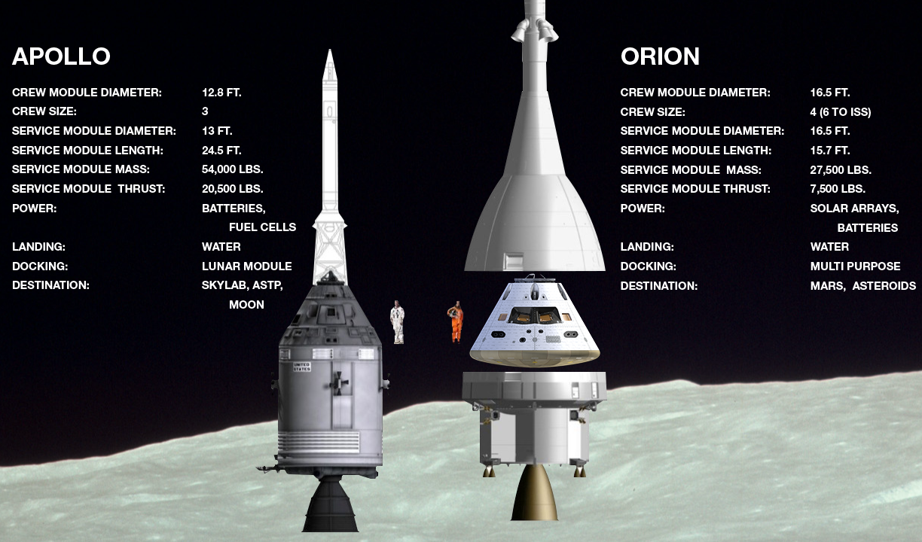
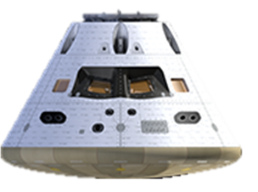

COMMAND AND SERVICE MODULE
Notes:
Life support
Apollo had the cool rocket name. Artemis has the cool capsule name. Same basic design, but it’s a bit roomier and has better computers (supposedly have improved a bit since the 60s) However, you’ll see that there are some downwards arrows on the stats. The engine for Orion, being built by the European Space Agency, is a relatively feeble, so Orion cannot get as far as the Apollo capsule did. As with the rocket, this underpowered design is the result of having years of competing priorities – something that did not plague Apollo.
But Orion also proved itself on Artemis 1…
Source: Adapted from https://www.americaspace.com/2019/11/04/artemis-updates-2019-11-03/

Slide 16
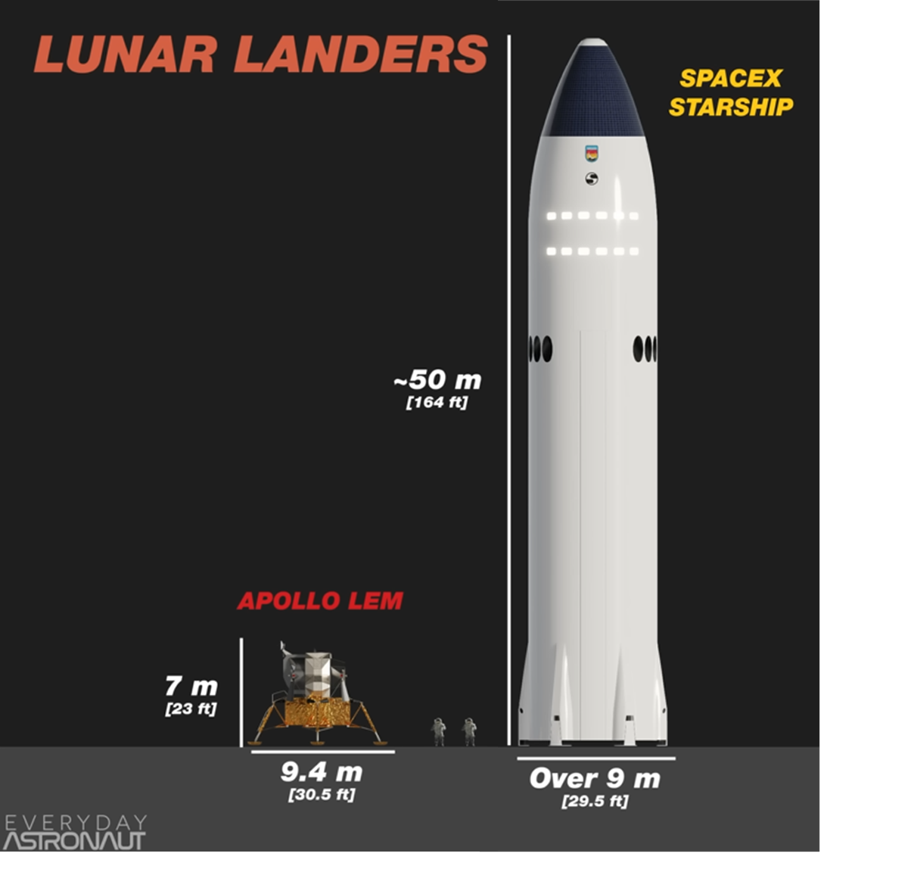
Notes:
Apollo’s lunar module was neatly tucked away inside the Saturn V, just below the command and service module. But SLS doesn’t have room for a lander, and NASA hadn’t been working on one anyway.
Under new commercial paradigm, put out a call to industry to come up with something
SpaceX were selected, being the only ones within the measly budget NASA was given from Congress.
However, you might say their proposal was slightly bigger.
Source: Everyday Astronaut YT

Slide 17
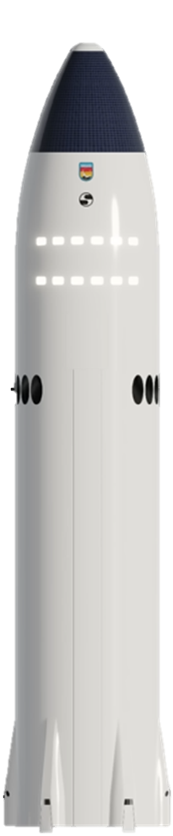

Notes:
Why so ginormous? Originally designed to send 100 people to Mars, the long-term goal of SpaceX. Just like the rest of the Artemis vehicles: really not optimised for a moon landing! But because already investing so much capital in it, SpaceX was able to offer their lander for half the price of the next cheapest option, despite being the most silly looking.
So the idea here is that Orion will dock with Starship in lunar orbit, transfer the astronauts, who will then descend to the surface. To do this, Starship needs to launch on its own rocket, which as you might expect, is also quite large.

Slide 18
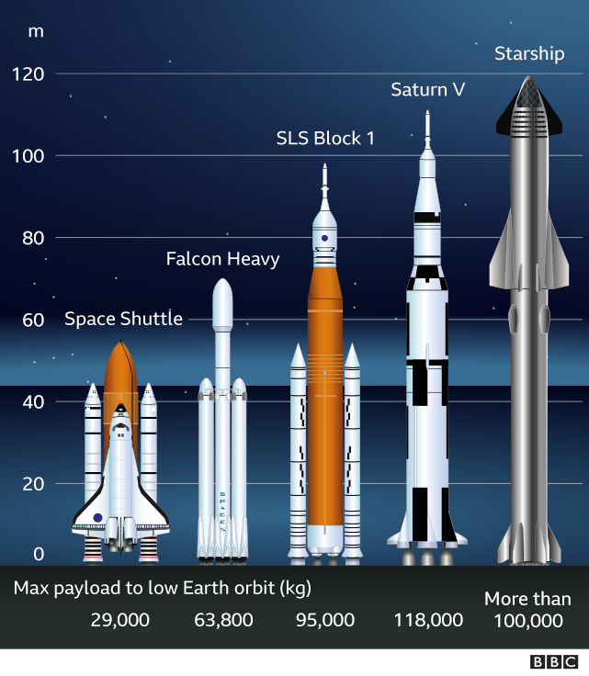

All “super heavy lift” launch vehicles to have flown
+ Electron
320
Notes:
The full Starship launch vehicle is even taller than Saturn V, double the thrust, courtesy of its 33 engines, and designed to be fully and rapidly reusable.
This system truly revolutionise the economics of space if it is successful, including making the fully disposable SLS redundant. But it’s not there yet.
Lander = most unproven and technically challenging part of the whole program. But SpaceX have proven they can do incredible things, and we are seeing progress.
Super heavy = >50 metric tons (shuttle qualifies if including orbiter)

Slide 19
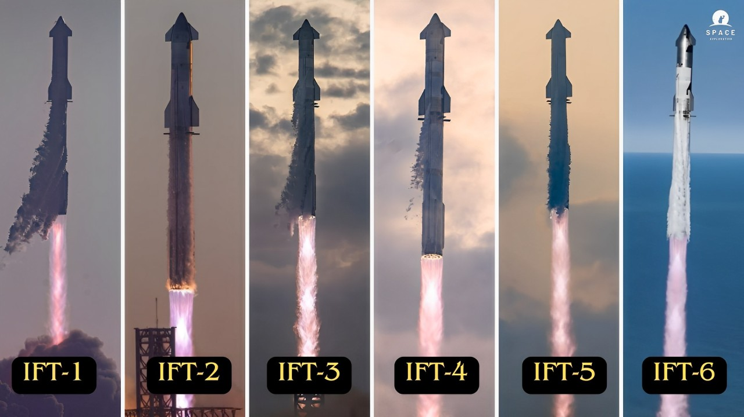
Notes:
From their rocket factory in South Texas, they’ve actually built and tested six starships now.
Have been some explosions along the way, but that approach to testing is what has allowed them to iterate and improve so quickly. Led to a particularly inspiring triumph of engineering on Flight 5 earlier this year.

Slide 20
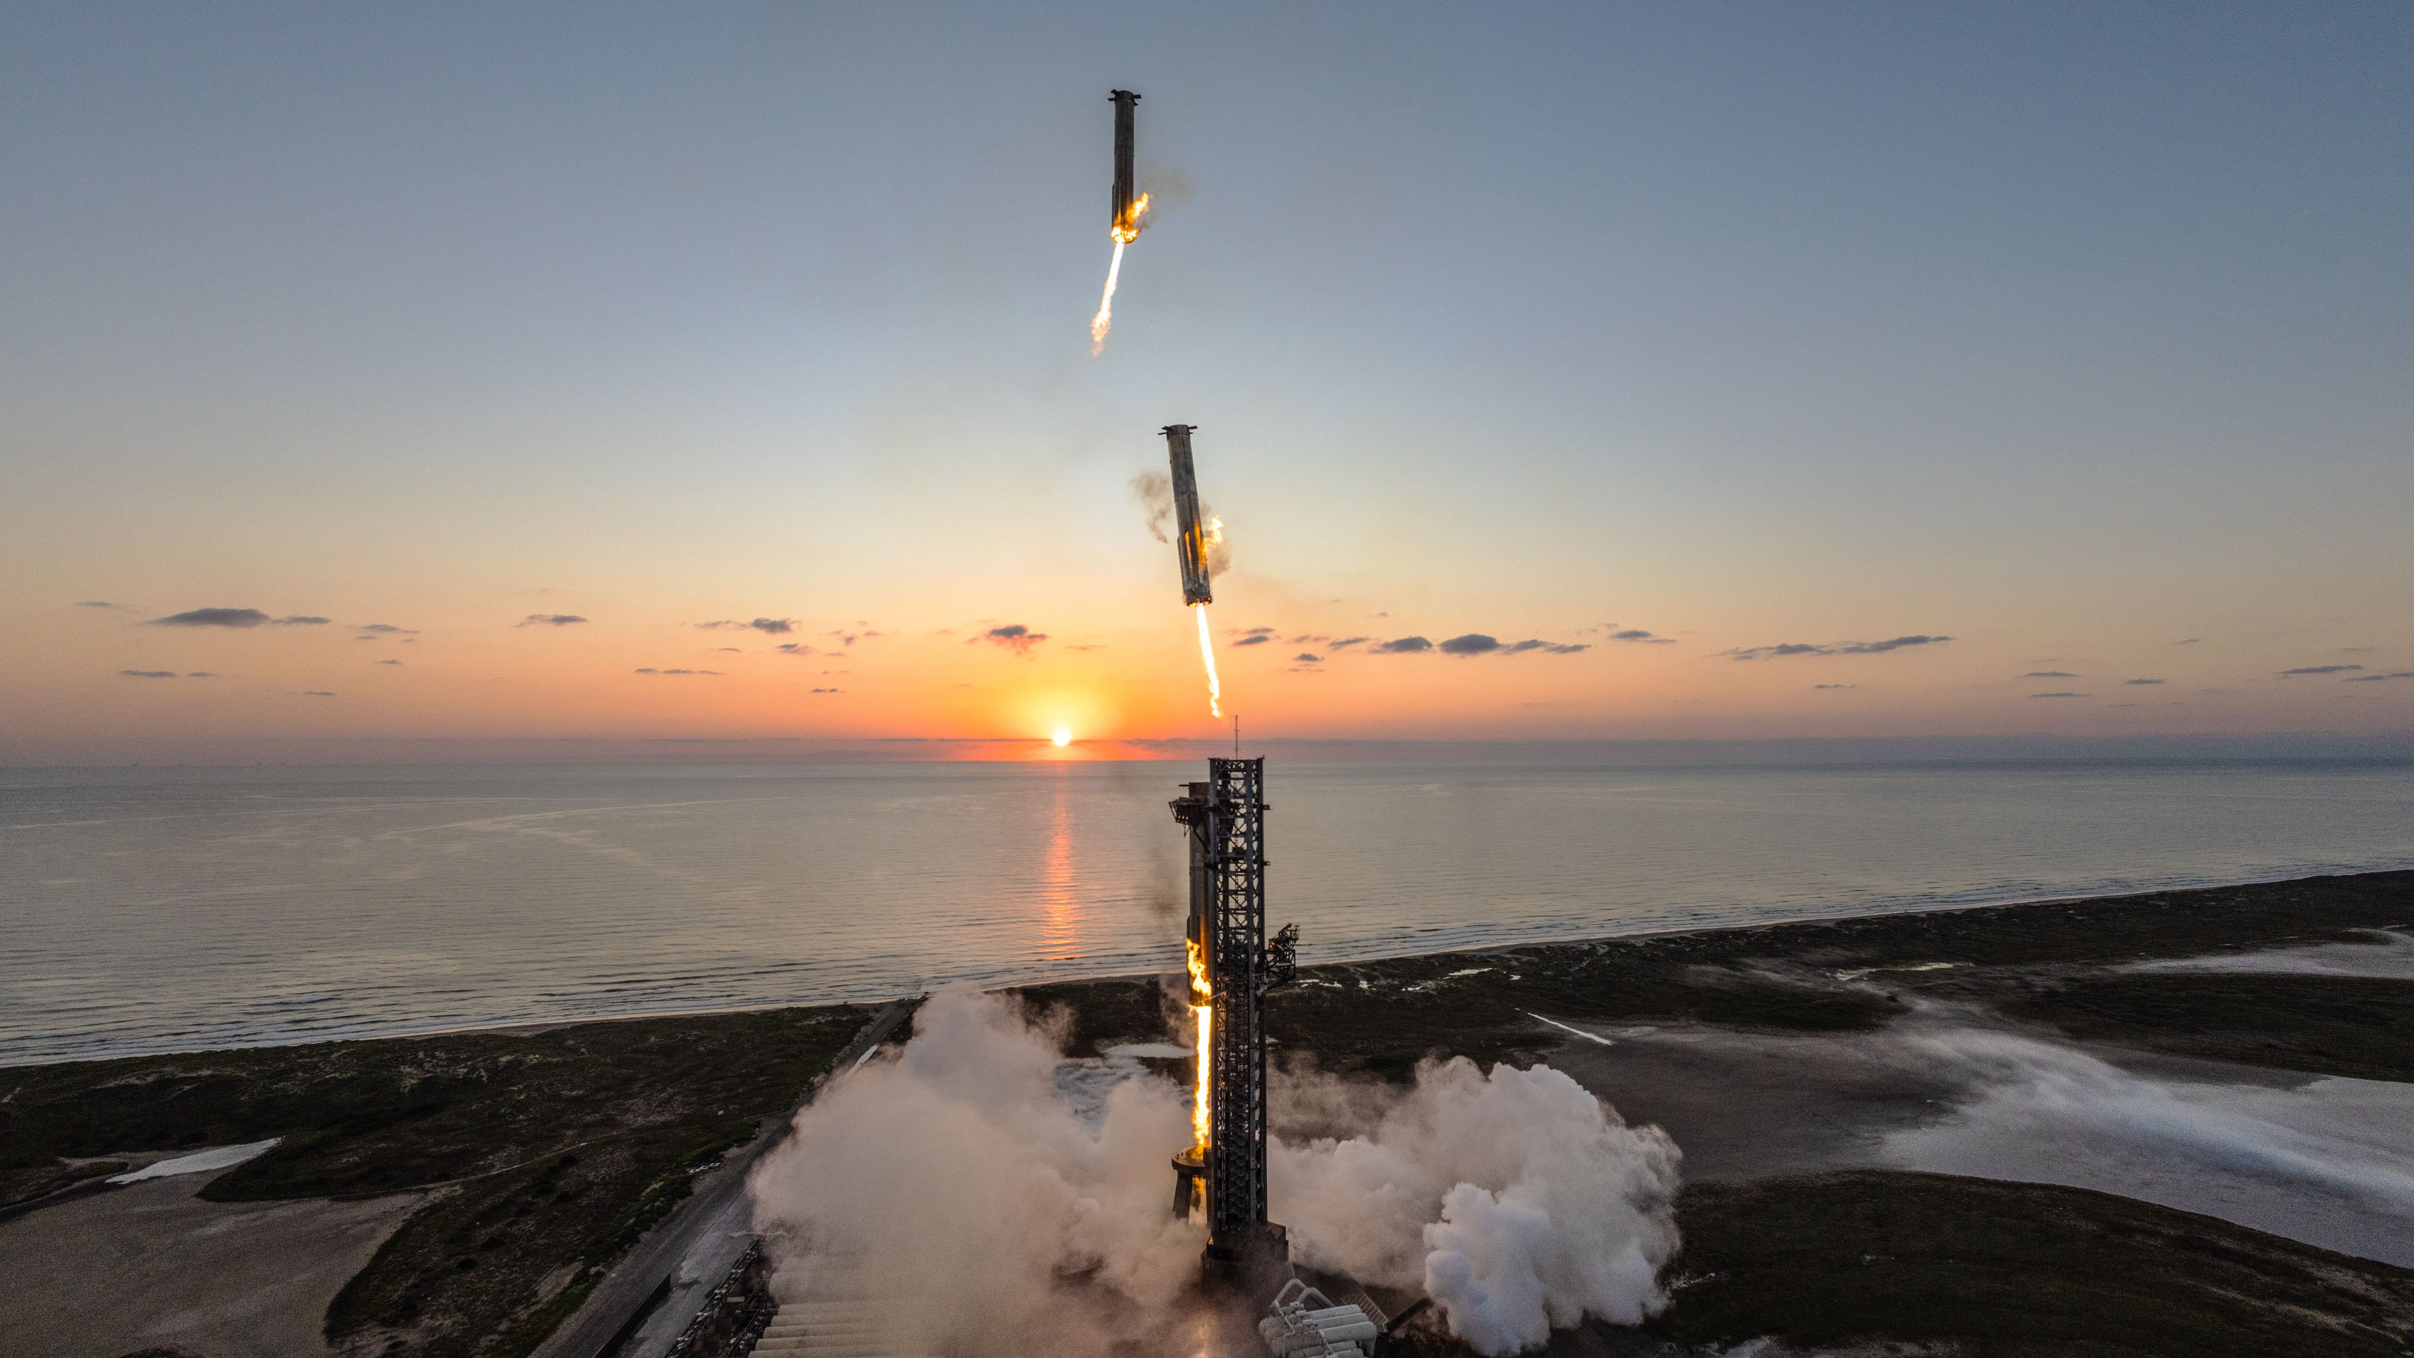
Fifth test flight of Starship October 2024
Notes:
This time lapse shows that 70m booster section returning to the launchpad to be caught by two giant arms. This is key to rapid reusability.
Next milestones: land landings, in-orbit refuelling, and land without people on the Moon.
Only then NASA will be ready to put astronauts in it.

Slide 21
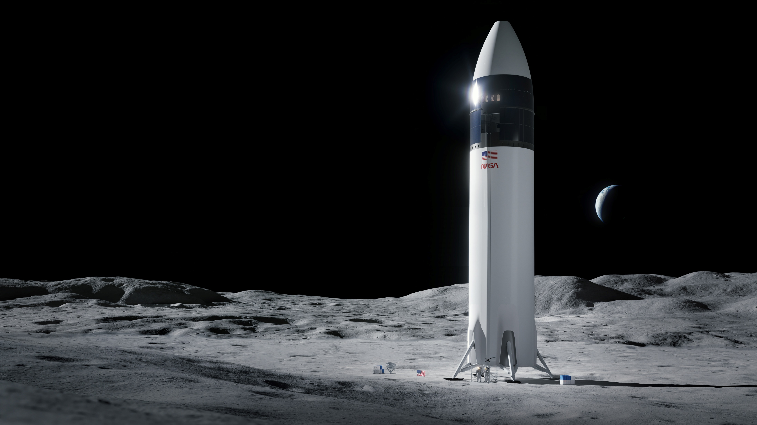
Artemis III 2024 2027?
Notes:
Artemis III is planned to see the first woman on the Moon, as part of a week-long stay at the South Pole.
2024 is obviously not happening (sorry Mike Pence). The schedule has slipped multiple times: 2027 is the latest official timeline: certainly knocking on the door of the Chinese timeline.
Once the astronauts eventually get there, take lift down from their 15-storey lander, what are they going to do there? Let’s again compare with Apollo.

Slide 22
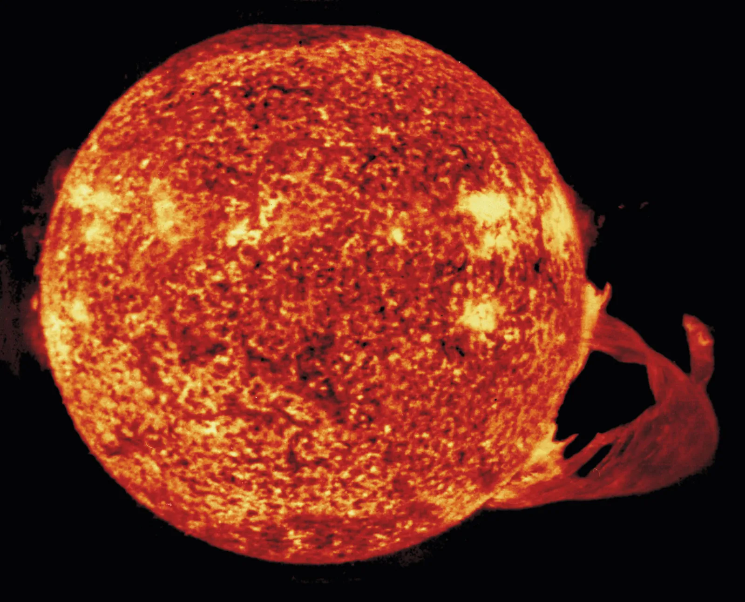
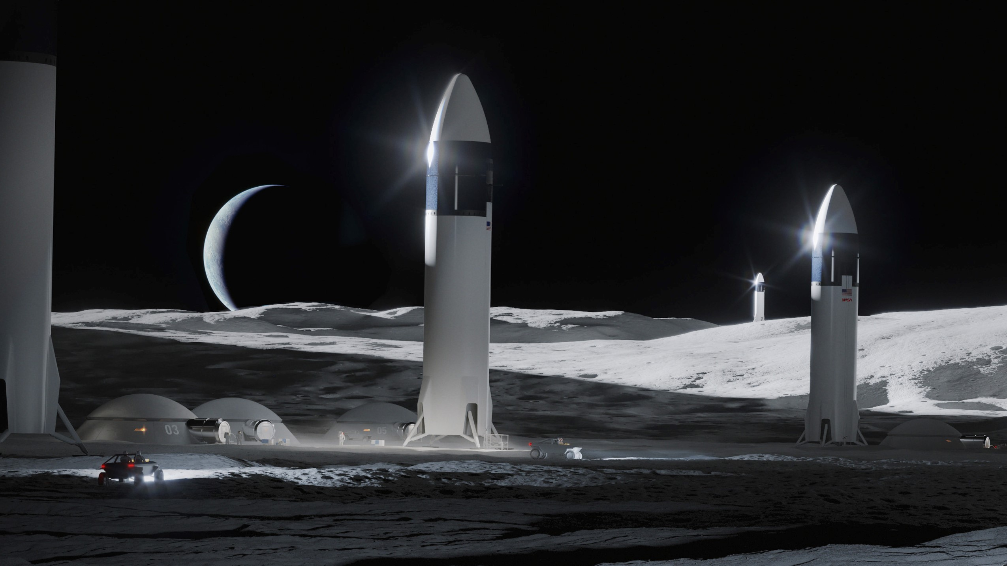

2030s and beyond?
Habitats
Pressurised rovers
Lunar space station “Gateway”
Ice mining operation
…if we manage to solve:
Radiation shielding
Dust management
Living in 1/6th gravity
Notes:
What NASA envisions by the 2030s is a so-called “sustainable presence”: proper base camp with habitats, pressurised rovers built by Japan. A mini space station orbiting the Moon. Expeditions into those dark craters, and, if they bring back good news, an ice mining operation.
But remember, this is a song of ice and solar flares. One of the many miracles of the Apollo missions was that they managed to miss the massive solar storms of 1972. Storms which exploded sea mines off the coast of Vietnam, and would have delivered potentially lethal doses of radiation to anyone outside the Earth’s magnetic field. Without an atmosphere or magnetic field, the Moon is incredibly exposed to high energy particles from the Sun, which can cause both radiation sickness and greatly increase the risk of cancer. One of the ideas is using the Moon’s soil, called regolith, as protection. If anyone’s interested, I’m happy to talk more afterwards about solar flares and space weather, as it’s quite relevant to my PhD research.
And space weather is by no means the only hazard: there’s also the sharp lunar dust, 300 degree temperature swings, 1/6th gravity: all of these need new technology solutions if we’re talking about living on the Moon for weeks at a time, not just a weekend.
So, to sum up, what should you make of NASA’s grand vision for the next 10-20 years? Is this just another doomed attempt at recreating their glory days? And if not, does NZ have any role to play?

Slide 23
THE CHALLENGES OF THIS NEW ERA
Resource management. How do manage competing demands for
Satellite internet
Clear skies for astronomy
Cultural concerns
Conflict in space
Keeping humans alive

Slide 24

Outer Space Treaty (1967)
Treaty on Principles Governing the Activities of States in the Exploration and Use of Outer Space, including the Moon and Other Celestial Bodies

Slide 25


Artemis Accords (2020) Principles for Cooperation in the Civil Exploration and Use of the Moon, Mars, Comets, and Asteroids for Peaceful Purposes

Slide 26





















Sputnik to Starlink
Notes:
Artemis is undoubtedly a more complex program than Apollo, both in motivation and in execution. But this could just be its staying power.
The new vehicles and longer missions present major technical challenges that still need to be solved. And a big part of solving these challenges is money. As of yet, there is no economic incentive to go to the Moon, so it’s really dependent on the priorities of politicians. Priorities that often don’t lead to sensible technical solutions, as we’ve seen with NASA’s latest rocket. And despite the bipartisan support, so far Artemis hasn’t received close to the same level of funding that Apollo did, probably because there’s no longer an existential geopolitical rivalry and a murdered President’s dream to bring the US together and provide a compelling reason to go.
But as I’ve also described, this time around, 50 years later, there are new advantages, including 3 real game-changers. Firstly, there is a global space sector, providing opportunities for both competition and cooperation. Secondly, there is an innovative private industry led by SpaceX, not to mention our own Rocket Lab. Having all these players involved increases the complexity of the program, but it also makes it harder to cancel, and reduces the financial burden on the American taxpayer. A taxpayer who has never been that supportive of big space programs, even during Apollo. Thirdly, we also now know that lurking in deep shadows at the Moon’s poles is one of the ingredients for both life and rocket fuel.
And perhaps the most crucial difference from Apollo, is that Artemis was founded on both a short-term deadline and a long-term vision, aiming not just to plant a flag and come home, but to put the first woman on the Moon, establish a permanent presence there, and prepare for Mars.
So, the reality we’re left with is, for only the second time in history, there is momentum to push humanity beyond low Earth orbit. And more than ever, to keep going, and do it together. That includes New Zealand!

Slide 27

















The Moon is a Harsh Mistress Robotic landing attempts so far this century
5 successes
2 partial
5 failures
☑
☑
⮽
⮽
☑
⮽
☑
⮽
☑
⮽
☑
☑
Notes:
Here’s the scoresheet of the lunar renaissance. While China is 4 from 4, the other missions so far this century have been a real mixed bag: just over half have made it in one piece. Among those have been Japan and India for the first time, as well as the first private company, Intuitive Machines, who were contracted by NASA to deliver scientific instruments to the Moon. Partnering with the private industry is an important strategy at NASA these days.
This brings us to the second game-changer for Artemis.

Slide 28

REQUIREMENT #2 A way to get there Rocket, capsule, lander
“Mega Moon Rocket”
“Antiquated Frankenrocket”
“Senate Launch System”
a.k.a.
Notes:
With Apollo, NASA was starting from scratch, and always had a clear goal of landing a man on the Moon and returning him safely to the Earth. As a consequence, with an open chequebook, able to really optimise their mission architecture for this one job.
Artemis, on the other hand, is the child of cancelled government programs and the commercial industry; resulting in a hodgepodge of vehicles, both retro and futuristic. This architecture has copped its fair share of criticism, not least the biggest part: the rocket.
Apollo had the behemoth Saturn V, Artemis has this slightly smaller orange rocket called the Space Launch System, or SLS. Which has copped a number of nicknames, some more flattering than others. That last one is because while the Saturn V was designed by ex-Nazi von Braun, the SLS was effectively designed by the US Senate.
What do I mean by this? Well, after the Shuttle was retired, lots of people were going to be out of work. Senators in those states thought, well, if we can keep as much of the shuttle hardware as possible in this new rocket, we can keep a lot of the workforce there too. core, boosters, literal engines.
What we’re left with is a rocket with not only a much more boring name than Saturn V, but also less capable, able to send just half the mass to the Moon. And, despite so-called “heritage” hardware, still very expensive: $6B/launch. Not exactly the recipe for a sustainable program. But it has at least had one launch.
Source: https://www.bbc.com/news/science-environment-62563720
Jobs were a big reason why Nixon approved the shuttle in the first place

Slide 29


Artemis I November 2022
$5,999,999,999
$499
Notes:
In what was quite a spectacle, turning the Florida night into day. I wasn’t in front of a computer at the time so I ended up having to watch the livestream on my phone. The fact I could do that is another huge difference. Back in 1969, people in New Zealand could only watch delayed coverage of the landing, after the grainy black and white footage had been flown over from Australia. As for when the next person walks on the Moon, there’s bound to be 1000 high-definition TikTok remixes to enjoy before they even step off the ladder.
And in another public-private partnership, you can celebrate the debut of NASA’s new rocket by popping down the Lego store on Willis St and buying your own one, or perhaps as a nice Christmas present for the grandkids, at 0.00001% the cost of the real thing!
This was unmanned, but in future missions, astronauts will sit right up the top inside the second vehicle, the capsule.

Slide 30


Artemis I December 2022
Notes:
, performing a month-long loop around the Moon. From there 430,000km from Earth it took this nice selfie, before flying home and splashing down in the ocean. Nearly perfect, but NASA is investigating some unexpected damage to the heat shield.
Once they’ve figured that out, they’ll be ready to put people onboard and test out Orion’s life support system. That is the job of the next mission

Slide 31


Artemis II 2026
Victor Glover Pilot
Jeremy Hansen (CSA) Mission Specialist
Christina Koch Mission Specialist
Reid Wiseman Commander
Notes:
Artemis II. Last Friday it was delayed to 2026 after damage to the heat shiel on Artemis 1 had to be investigated. 10-day trip, loop around the Moon and come back
Roughly equivalent to Apollo 8, will be first time humans will have left earth orbit in 53 years.
Already seeing diverse crew: even a Canadian! NASA will be bringing Europeans and Japanese astronauts along on future Artemis flights.
Won’t be landing yet. For that we need the third and final vehicle.

Slide 32

Crying for the Moon?
2004
2010
To an asteroid! And Mars in the 2030s?
Mate, you’re dreaming
Back to the Moon, by 2020!
Notes:
Echoing a vision laid out by his father 15 years earlier, Bush said the US would return to the Moon by 2020 and then go onto Mars. But without a solid geopolitical reason or a cheaper way to do it this time, Congress didn’t stump up the necessary cash, just like they didn’t for the elder Bush.
Which means you’re just waiting for the next guy to come along, see how far behind schedule and over budget the program is, and cancel it. Obama’s position was, we’ve done the Moon – we’ll go to Mars via an asteroid instead! This wasn’t particularly inspiring, especially that 20+ year timeline for boots on Mars. Also gathered no momentum.
This is all the kind of flip-flopping and dilly-dallying in human spaceflight policy that has frustrated space advocates for decades.
Then comes the administration of Make America Great Again, part 1. Does that include US leadership in space?
Journey to Mars also alienating for commercial and international partners: much harder to participate than just going to the Moon (Pace, 2019)
https://georgewbush-whitehouse.archives.gov/news/releases/2004/01/20040114-3.html
https://obamawhitehouse.archives.gov/the-press-office/remarks-president-space-exploration-21st-century

Slide 33

To the Moon!
2017
Notes:
Well, in 2017, Trump signed Space Policy Directive 1, re-directed NASA back to the Moon. NASA, thinking “here we go again”, got back and said optimistically, they could get there by 2028.
This is when things change. VP, as head of revived National Space Council, says not good enough. Americans on the Moon within 5 years
https://www.nasa.gov/news-release/new-space-policy-directive-calls-for-human-expansion-across-solar-system/
https://www.flickr.com/photos/nasahqphoto/31654423388/

Slide 34



To the Moon!
By 2024!
2017
2019
Notes:
Trying to have his Kennedy moment, but he seriously overcooked it, coming up with a ridiculously ambitious timeline. But for the first time since JFK, a sense of urgency. Artemis born
Pence gets big photo on this slide because he really made his mark – Trump never gave any major space policy speeches. He was really only interested in Space Force, and the little he did say about Artemis was a bit incoherent about his own administration’s policy. In typical Trump fashion, came via Tweets…
While this does seem a bit contradictory, Trump highlights a common widespread reluctance to repeat Apollo – this is exactly what Obama said when he cancelled Bush’s plan to go back. But this is the sensible approach.
Ok, so we finally have another near-term deadline, albeit a crazy one. But if we learnt anything from Apollo, it’s that what you really need to get your stingy politician to pony up, is a competitor. The first of our 3 game-changers of the 21st century is the rise of China. Not only do they now have their own space station, but they’re also proving themselves to be very adept at landing stuff on the Moon.
Pence quotes (March 26, 2019):
"That's just not good enough. We're better than that. It took us eight years to get to the moon, the first time, 50 years ago, when we had never done it before, and it shouldn’t take us 11 years to get back”. Well, it probably will. “What we need now is urgency,” Pence said.
https://www.nasa.gov/news-release/new-space-policy-directive-calls-for-human-expansion-across-solar-system/
https://www.flickr.com/photos/nasahqphoto/31654423388/

Slide 35




A Chang’e in Competition
GAME CHANGER
#1
Yutu-2 rover 2019
Chang’e 4 lander 2019
Chang’e 3 2013
Chang’e 5 2020
Chang’e 6 2024
Notes:
They have done the same as the US and named the missions after their goddess of the Moon, Chang’e. In 2013, their Chang’e 3 lander ended humanity’s nearly 40-year abandonment of the Moon. They have since followed that up with 3 more robotic landings, including the first landing on the far side of the Moon. Chang’e 5 and 6 even brought back rock samples to Earth.
Note footprints in the center of logo: not intending to stop with robots! Goal of 2030 landing (announced May ‘23). Revealed space suit design in September. Fairly believable, given their systematic approach that has been very successful so far, with none of that pesky democracy to slow things down

Slide 36

Starlink
SpaceX their own biggest customer these days
https://www.sciencenews.org/article/satellites-spacex-problem-space-pollution
https://arstechnica.com/space/2024/02/spacex-takes-a-proactive-step-toward-responsible-behavior-in-orbit/
https://spacenews.com/growing-risks-in-low-earth-orbit-demand-more-responsible-space-behavior/
https://zapatatalksnasa.com/2023/08/23/three-graphs-and-a-truck/
https://satellitemap.space/
Notes:
The first of the so-called “megaconstellations” of internet satellites. Available in NZ
8,000 so far – at least 12,000 planned. X launches scheduled this week. Others planned: Amazon, Chinese.

Slide 37

Artemis survives a change of administration
Notes:
Clearly conditions for a return had improved, because the program survived when Biden took over.
1 reason for the bipartisan support of Artemis is that big space programs create jobs, and the NASA industrial complex stretches far and wide across the US. But another reason is that from its inception, Artemis was marketed very well.
Sold as not just about going back, doing something we’ve already done. Putting first woman on the Moon, the first person of colour. Decent goals, because Apollo…

Slide 38

Apollo: small steps for white American military men
Geologist!
Notes:
… was not exactly a giant leap for diversity: the furthest they got was including a single civilian scientist on the final mission
Product of its time: good that now the ambassadors of humanity are a bit more representative.
Source: Bob Farwell, https://www.nasa.gov/history/alsj/alsj.funpix.html

Slide 39
Recap: Reasons to go
Nationalism: One-up the USSR by the end of the decade
Nationalism
Beat China
Go with international partners
Put first woman and person of colour on the Moon
Scientific discovery
Create a long-term presence… and use as a stepping stone to Mars
Notes:
So how do things compare in terms of motivating each program?
Apollo managed to justify its cost solely in beating the Russians, potentially helped by a desire to fulfil the ambitious goal of a murdered President.
Artemis has a much broader set of motivations: yes, still has a geopolitical element, but it is also about greater collaboration and new milestones.
Science much more at the forefront this time, as is the long-term goal of setting up a base and using it to prepare for that next giant leap: setting foot on Mars
What does this mean, to be a stepping stone. Not just a lot closer. A place practise using the resources of another world, rather than having to bring everything with you. Time to bring in the science, and with it the third and final major development this century that has really brought the Moon into focus again.

Slide 40




Entrance to lava tube in Mare Tranquilitatis
Rille in Aristarchus Plateau
Mountain range in Zeeman crater (as tall as Everest)
Reiner Gamma lunar swirl
Notes:
but it does have some cool features that we should go and check out. Including these fascinating, and potentially very useful, formations called lava tubes: essentially giant caves formed by the passage of molten rock, that could provide effect shielding against radiation and provide a more stable temperature.
The Moon’s main scientific value is as a time capsule of the early solar system: contains rocks billions of years old, rocks that would have since been recycled countless times on Earth by erosion and plate tectonics. Processes that simply aren’t active on the Moon. And it’s not just geology: there’s real potential make breakthroughs in astronomy by putting telescopes on the farside of the Moon.
So that’s the science and potential resource utilisation that are the final part of the motivation for going this time around. Which, brings us to second question underlying a space program: how do we get there?
Clockwise from top left: pit entrance to lava tube in Mare Tranquillitatis, rille in Aristarchus Plateau, Reiner Gamma swirl, Zeeman Mons (8km, almost as tall as Everest)

Slide 41




Apollo XI-XVII 1969-72
6 landings
12 moonwalkers
80 hours on the surface
90km traversed
400kg of rocks collected
2 golf balls hit
Notes:
Diary of those six landings. Essentially a series of short camping trips
Plant flag, pick up rocks, do some science experiments, try not to fall over
Later missions: go for a drive, pick up some more interesting rocks from further away
Then they packed up and came home, after no more than 3 days. Solar flare transition, using regolith as shielding. Radiation a much bigger problem for the Moon than Mars
But Artemis has much bigger plans: not just the giant landers
https://www.britannica.com/place/Moon/Lunar-rocks-and-soil
Alan Shephard hit a golf ball 40 yards on Apollo14

Slide 42






CODA
Aotearoa, Artemis, and the ethics of exploration
Notes:
We are already contributing. In the private sector, Rocket Lab launched a mission back in 2022 to study the orbit of a future lunar space station. Auckland company Lanaco is putting NZ wool onboard Orion, in the form of air filters for astronauts to use in case of a fire.
At a government level, we have signed the Artemis Accords, saying we agree with America’s principles for cooperating in space. These include a basis for property rights on other worlds. Which brings us to the legal and cultural side of this new age of exploration. A number of indigenous and environmentalist groups around the world, including Māori, have raised concerns about capitalism and colonialism beyond the Earth. Questions like, how do we fairly manage resources in space? Is it OK to send someone’s ashes to the Moon? Should we be concerned about the role billionaires are playing in this new era? These are all important issues that deserve a whole talk of their own.
But as countries and companies start setting up shop at Shackleton Crater, I think we can use our experience on Antarctica to promote peaceful scientific cooperation in a hostile environment. With our soft power and innovation, New Zealand can highlight the many good reasons to go - not to just win a race, but to work together to explore the unknown, develop new technologies, inspire the next generation, and
https://www.cie.auckland.ac.nz/newsroom/the-venture-taking-new-zealand-wool-to-the-moon/
Artemis Accords on space resources: The Signatories emphasize that the extraction and utilization of space resources, including any recovery from the surface or subsurface of the Moon, Mars, comets, or asteroids, should be executed in a manner that complies with the Outer Space Treaty and in support of safe and sustainable space activities. The Signatories affirm that the extraction of space resources does not inherently constitute national appropriation under Article II of the Outer Space Treaty, and that contracts and other legal instruments relating to space resources should be consistent with that Treaty.

Slide 43


A Song of Ice and Solar Flares Returning humans to the Moon this decade
Notes:
give more people the opportunity to look back at our home, floating in the blackness.
Image from Apollo 17: http://tothemoon.ser.asu.edu/gallery/Apollo/17/Hasselblad%20500EL%20Data%20Camera%2070%20mm#AS17-137-20961
See also JAXA’s Selene orbiter https://www.theatlantic.com/photo/2017/04/portraits-of-the-earth-moon-system/524121/#img08

Slide 44



A very cool discovery
GAME CHANGER
#3
H₂O!
SOUTH POLE
Notes:
Rocks that the Apollo astronauts brought back showed no sign of water: Moon must be completely dry.
However, the Moon has these craters at its poles which are permanently shadowed. Craters like Shackleton here haven’t seen the Sun for perhaps billions of years. In 2009, a satellite orbiting the Moon discovered chemical signature of water ice in these craters. This has led to a lot of excitement. Water could be a real boon for exploration and settlement: could make the Moon a pit stop on the way to the rest of the solar system. But there are still lots of unknowns: know it’s there, but don’t know how much or how easily accessible.
Therefore, in order to find out, the South Pole is the target for both the American and Chinese lunar bases.
Moon less boring than guessed. << Sure, it’s much less colourful and geologically diverse than Earth…

Slide 45

Notes:
https://trailblazer.caltech.edu/index.ht
How does it stay there? Not ablated by zero atmosphere?

Slide 46



2 questions for sending humans into deep space
1961-1972
2022-
Why?
Nationalism
Scientific discovery
Economic benefit
Long-term survival
How?
Rocket
Capsule
Lander
Have a picnic?
Notes:
So, if you’re serious about sending people into deep space, i.e., beyond earth orbit, you need to answer two questions convincingly.
1. Why send people to these extremely inhospitable places, when you could send robots for a fraction of the cost: here are some commonly cited reasons. Wallace and Gromit here would add, to sample the local cuisine – just don’t forget the crackers. You’ll notice I’ve put economic benefit. Just to be clear, this is largely through creating high-paying high-tech jobs. It does not mean mining the Moon or asteroids for profit. As it turns out, if you run the numbers, this is really not economically feasible, at least for the near future.
2. How do you actually get to where you want to go and back home again in one piece: most often consists of these three components.
This is the framework I’m going to use to compare Artemis with our one historical example in Apollo. As we’ll see, the answers to these questions look quite different this time around. And I’ll argue there are three real game-changers that have arrived on the scene.
Ok: two questions, two programs. Staring with Apollo, it was all about that first one.

Slide 47

Space weather
Solar flares
Bursts of electromagnetic radiation
Can cause radio blackouts
8min travel time
Coronal mass ejections (CMEs)
Bursts of solar material (plasma)
Distort Earth’s magnetosphere, causing geomagnetic storms
Can damage satellites, electricity grids, gas pipelines, astronauts
1-2 days travel time
Notes:
Sun’s surface, while appearing to us as a very bright but nonetheless unchanging source of light, is a writhing mess of magnetic fields and plasma. When these magnetic fields become tangled up, they can snap and release vast amounts of energy, in two particular forms.
CME took out Quebec’s power for 9 hours in 1989
Detonated sea mines off coast of Vietnam in 72 (right between A16 and 17)
1859: set fire to telegraph stations and woke up gold miners with global aurora

Slide 48


The threat of space weather
Notes:
Components of the space radiation environment. Operational space radiation environment is comprised of three sources of ionizing radiation, energetic protons from solar particle events, relativistic heavy ions of the galactic cosmic ray spectrum, and trapped electrons and protons in the Van Allen Belts
Radiation poses risk to all cells in the body.
Acute (short-term) effects: sickness, cognitive impairment
Chronic long-term effects: increased cancer risk https://www.nasa.gov/hrp/radiation/space-radiation-risks/
What can be done??? Shielding. Not as important on Mars as it has an atmosphere, but will be vital on the Moon for protecting from solar storms. Especially in the coming years.
Source: ESA and Fig. 1 from Chancellor et al., 2021 (https://doi.org/10.1080/26896583.2021.1897273)
https://ccmc.gsfc.nasa.gov/RoR_WWW/presentations/SSMO-2016/Zheng-SSMO_SEPLecture.pdf

Slide 49
Extra points (see Space essays doc for more)
Militarisation? Space as the new “high ground”
Moon probably doesn’t offer any military advantage, but potential for conflict over resources (recall both US and China-Russia bases to be set up at the South Pole). See Space law on following slides
Humans vs robots? Robots increasingly capable, but humans still needed for
Adaptability and initiative (for now): as I learnt from getting a B+, proper field geology is a real skill
Ensuring long-term survival of the species
Inspiration: vicarious exploration through astronauts, despite anthropomorphisation of robots, esp. Opportunity, Curiosity, Perseverance

